Slide 1
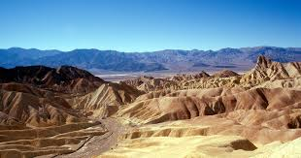
“Sliding Stones”
The Phenomenon

Slide 2
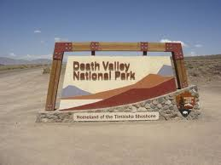
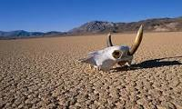
Background Knowledge- Partner Share
With your partner answer the following questions
Do you know where Death Valley is located?
Has anyone been to Death Valley?
What are characteristics of Deserts?

Slide 3
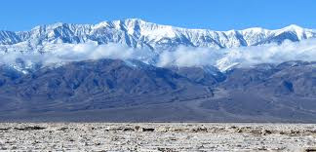
Procedure 1: (Work Individually)
Look at the two pictures on the next slide. Write your observations and questions on your “Cause and Effect Relationships” page.

Slide 4
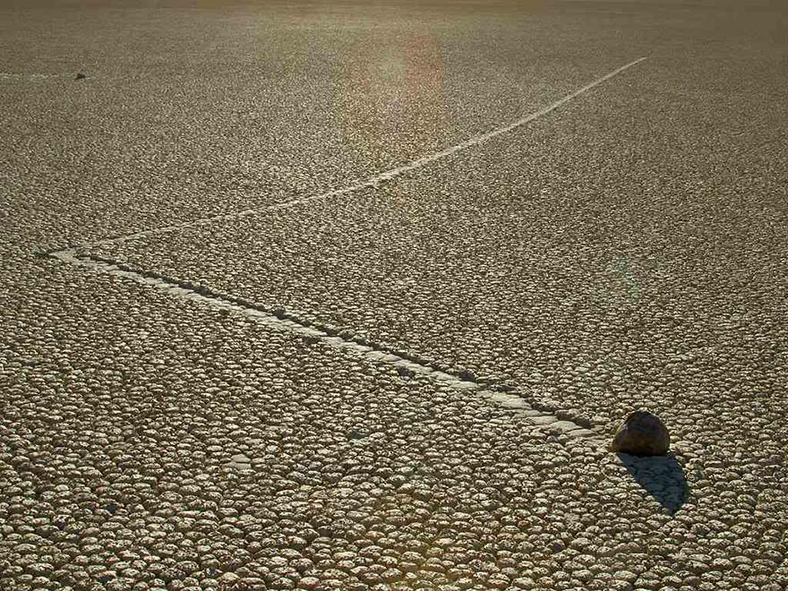
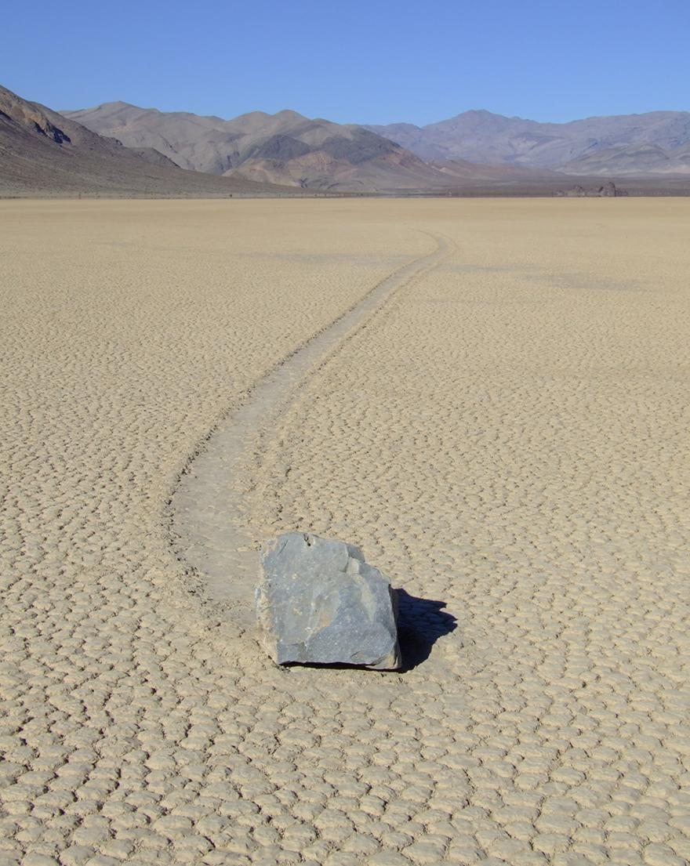
Making Observations/Formulating Questions

Slide 5
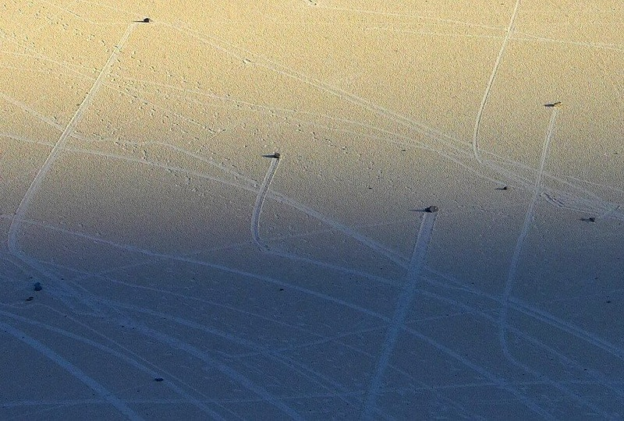
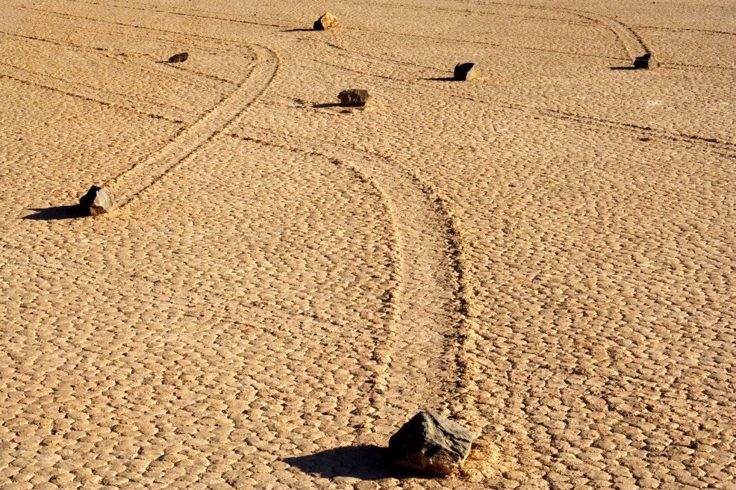
Procedure 2: Find a partner and write additional observations and questions while looking at these pictures.

Slide 6
Procedure 3:
Now as a table group share and discuss your possible explanations of the “phenomenon”.
Write at least two causes you have in the box on your “Cause and Effect Relationship” page.
Write at least two possible explanations of the phenomenon that you have looked at.

Slide 7
Procedure 4:
Look at the information provided and continue the discussion in your group.
Keep refining your explanation of the “event” on your “Cause and Effect Relationship” page.

Slide 8
Procedure 5: Watch the video and compare your explanation of the “event” to the explanation provided in the video.
Sliding Stones Explained

Slide 9
Procedure 6: Conclusion
Compare your group’s explanation the “Sliding Stones” phenomenon of the explanation provided in the video.
Together in your groups; formulate and share one comprehensive explanation of the “Sliding Stones” phenomenon. Each person needs to write this final explanation on the “Cause and Effect” page.
This is an opportunity to make sure every member of the group understands what causes the “Sliding Stones” in Death Valley.

