Slide 1
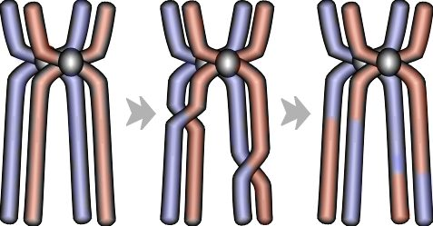
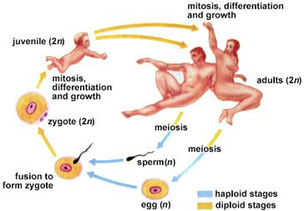
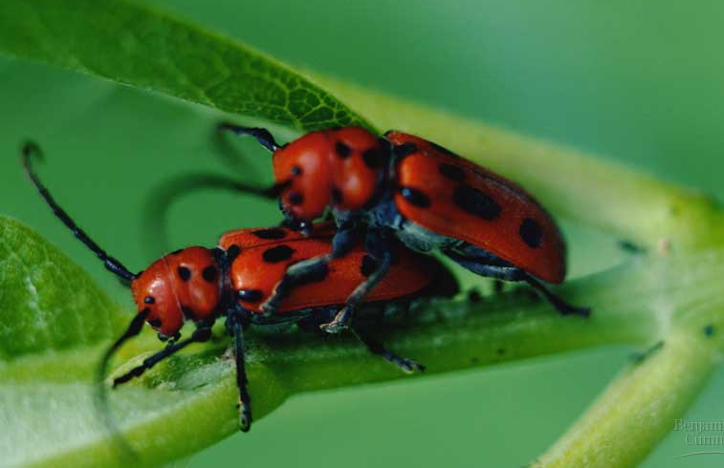
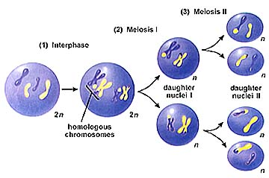
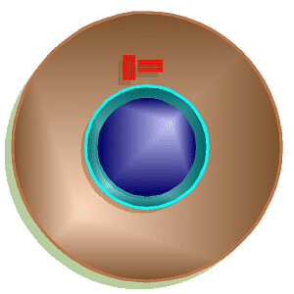
Meiosis &
Sexual Reproduction

Slide 2
Mitosis review
produces cells with the same information
  identical daughter cells
exact copies
  clones
same number of chromosomes
  same genetic information
Aaaargh!
I’m seeing
double!

Slide 3
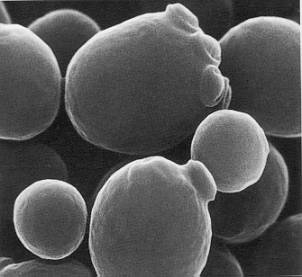
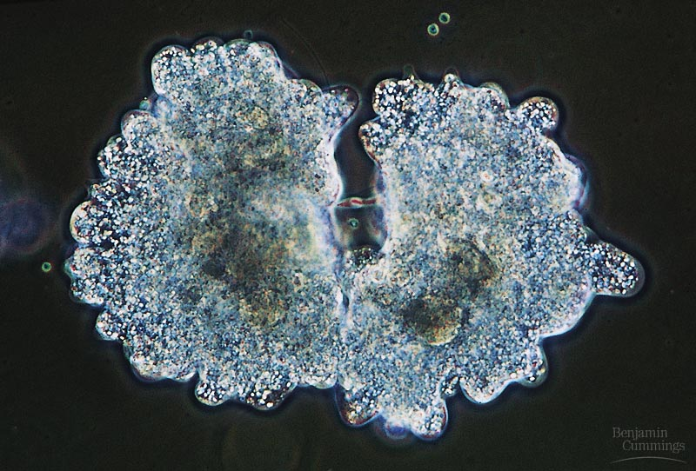
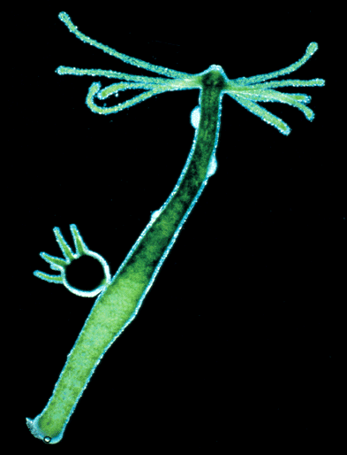
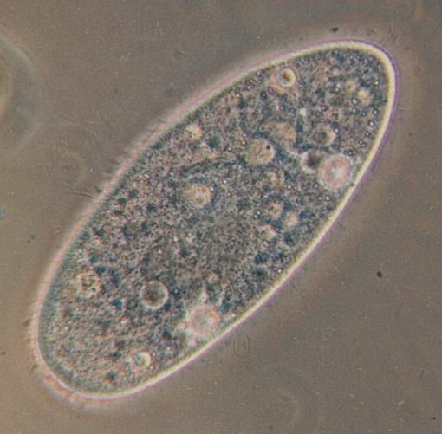
Asexual reproduction
Single-celled eukaryotes
  yeast
  Amoeba
  Paramecium
Simple multicellular eukaryotes
  Hydra
What are the
disadvantages of
asexual reproduction?
What are the
advantages?

Slide 4
How about the rest of us?
What if a complex multicellular organism (like us) wants to reproduce?
  Sexual reproduction = joining of egg + sperm
Do we make egg & sperm by mitosis?
No!
What if we did, then….
46
+
46
92
egg
sperm
zygote
Doesn’t work!

Slide 5
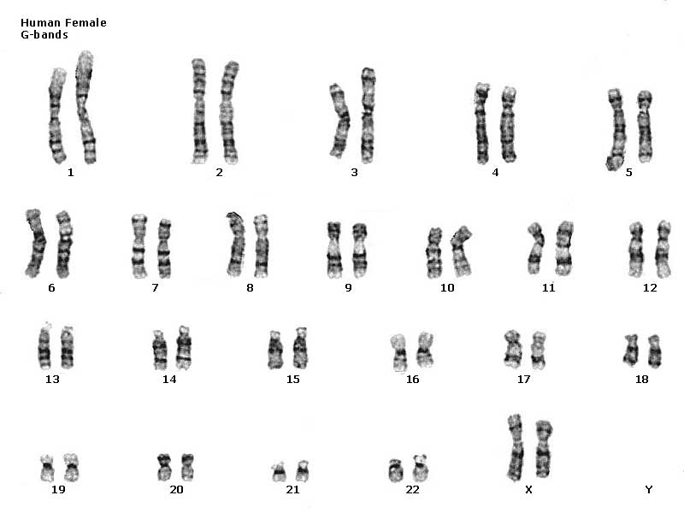
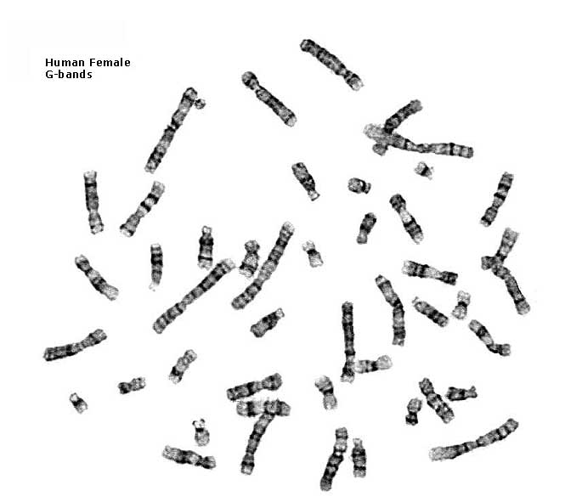
Human female karyotype
diploid = 2 copies
2n
46 chromosomes
23 pairs
XX

Slide 6
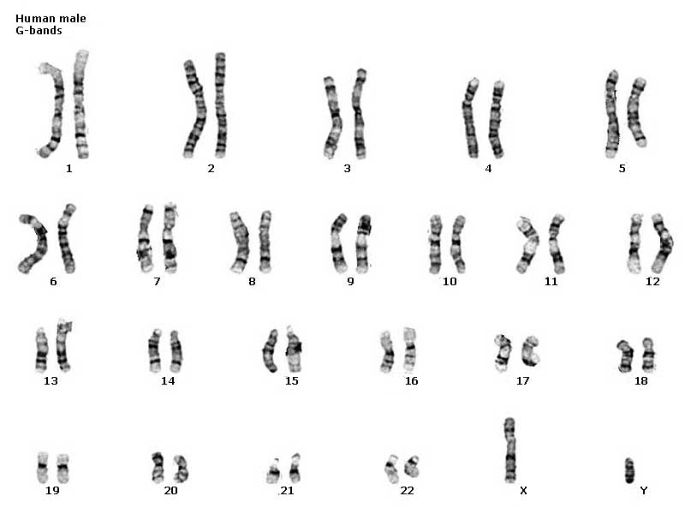
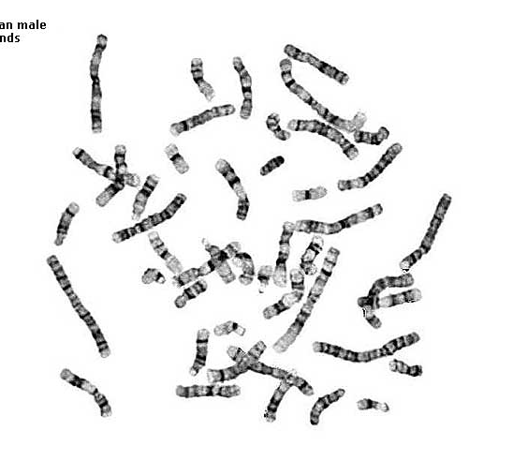
Human male karyotype
diploid = 2 copies
2n
46 chromosomes
23 pairs
XY

Slide 7
How do we make sperm & eggs?
Must reduce 46 chromosomes → 23
  Half the number of chromosomes
  Haploid = one copy of each chromosome
n
23
zygote
46
23
egg
46
meiosis
23
46
23
fertilization
sperm
gametes

Slide 8
Homologous pairs
both chromosomes of a pair carry “matching” genes
  control same inherited characteristics
  homologous = same information
eye color
(brown)
eye color
(blue)
diploid
2n
2n = 4
homologous
chromosomes
homologous chromosomes
after replication

Slide 9
Meiosis 1 overview
Pairs split
1st division of meiosis
Copy DNA
Line up pairs
prophase 1
metaphase 1
4 chromosomes
diploid
2n
Two pairs = tetrad
telophase 1
2 replicated chromosomes
haploid
n

Slide 10
Meiosis 2 overview
Sisters split
telophase 2
Line Up Chromosomes
4
2nd division of meiosis
  looks like mitosis
metaphase 2
2 unreplicated chromosomes
haploid
n
gametes

Slide 11
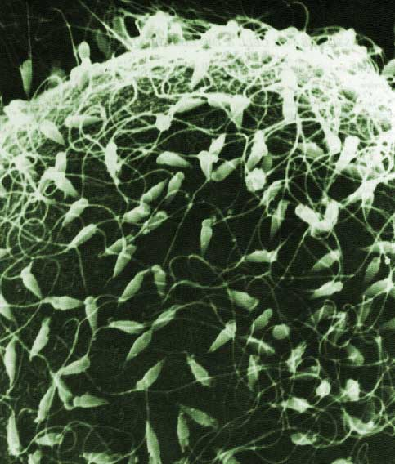
Meiosis summary
special cell division in sexually reproducing organisms
reduces number of chromosomes
  diploid → haploid
  2n → n
makes gametes
  Spermatogenesis = making sperm through meiosis
  Oogenesis = making eggs through meiosis

Slide 12
Why meiosis?
Consistency over time
  meiosis keeps chromosome number the same from generation to generation
from Mom
Mom
Dad
offspring
from Dad
Notes:
Consider the greater variation with 23 pairs of chromosomes = mixing and matching

Slide 13
Why meiosis? (continued)
Introduces genetic variation
  gametes of offspring are different than parents
  Independent assortment = random separation of homologous chromosomes
from Dad
variation
from Mom
offspring
new gametes made by offspring
Notes:
Consider the greater variation with 23 pairs of chromosomes = mixing and matching

Slide 14


More variation
Crossing over
  Occurs in Prophase 1
  Pieces of homologous pairs (tetrads) switch places
  Combines both parents’ genetic info
Meiosis 1
Meiosis 2
Prophase 1
even more variation

Slide 15

Crossing over video

