Slide 1
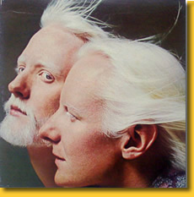
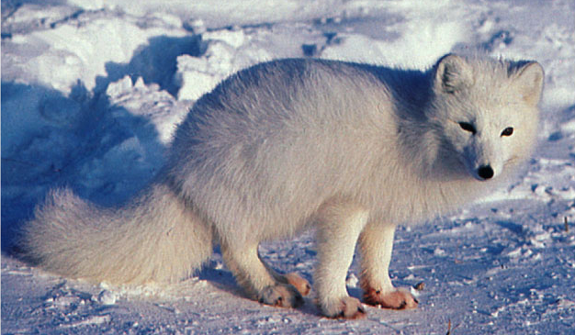
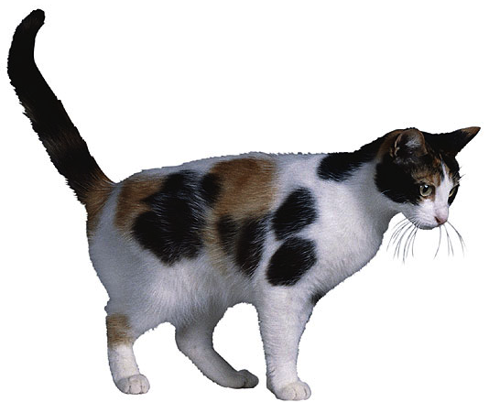
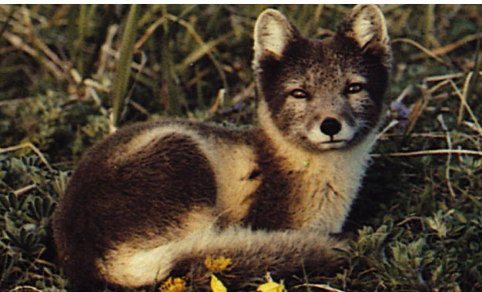
Beyond Mendel’s Laws
of Inheritance

Slide 2
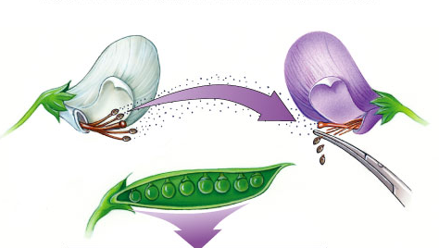
Extending Mendelian genetics
Mendel worked with a simple system
  peas are genetically simple
  most traits are controlled by a single gene
  each gene has only 2 alleles, 1 of which
  is completely dominant to the other
The relationship between
genotype & phenotype
is rarely that simple

Slide 3
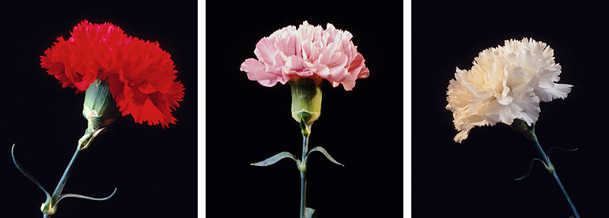
Incomplete dominance
Heterozygote shows an intermediate, blended phenotype
  example:
    RR = red flowers
    rr = white flowers
    Rr = pink flowers
      make 50% less color
→ RR
→ WW
→ RW
RR
RW
WW

Slide 4
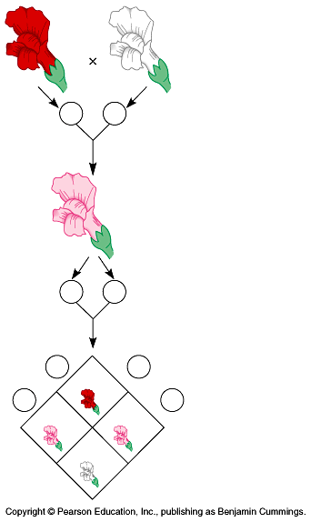
Incomplete dominance
P
true-breeding
red flowers
X
true-breeding
white flowers
RR
WW
100% pink flowers
F₁
generation
(hybrids)
100%
RW
RW
RW
RW
self-pollinate
25%
red
50%
pink
25%
white
1:2:1
F₂
generation
RR
RW
WW

Slide 5


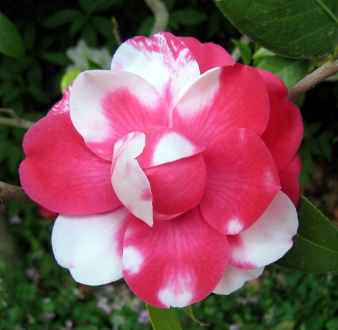
Co-dominance
2 alleles affect the phenotype equally & separately
  NOT blended phenotype
X
WW
RR
RW

Slide 6
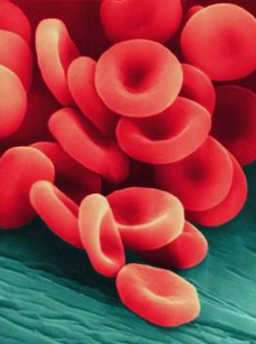
Co-dominance: Human Blood
Red blood cells have proteins (antigens) on their surface
  Can have A, B, A and B both, or none (O)
Rh factor: you have it (+) or you don’t (-)
The body will make antibodies for any unknown antigens
  Antibodies cause clotting called agglutination

Slide 7
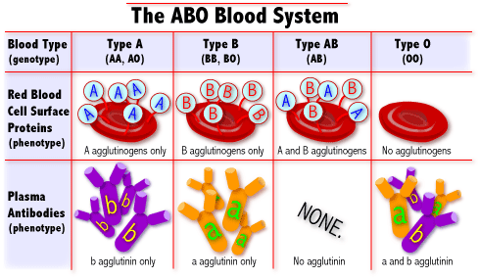

Slide 8
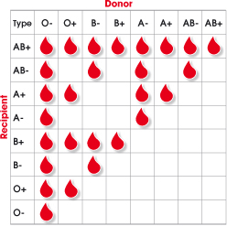
Blood transfusions
If you get blood that has an unknown antigen, your body will attack it and it will form clots (agglutination)
What is your blood type?
  What blood types could you get in a transfusion?

Slide 9
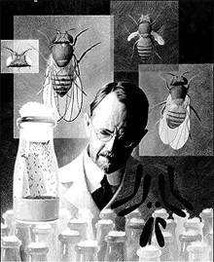
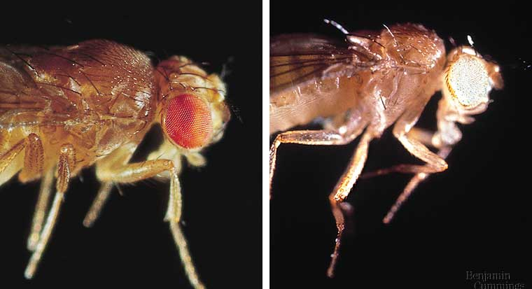
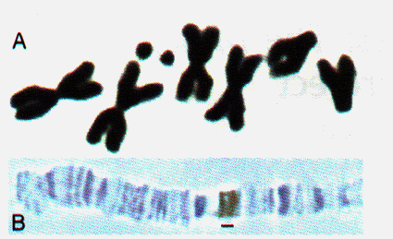
Sex linked traits
Genes are on sex chromosomes
  as opposed to autosomal chromosomes
  first discovered by T.H. Morgan at Columbia U. in fruit flies (Drosophila)

Slide 10
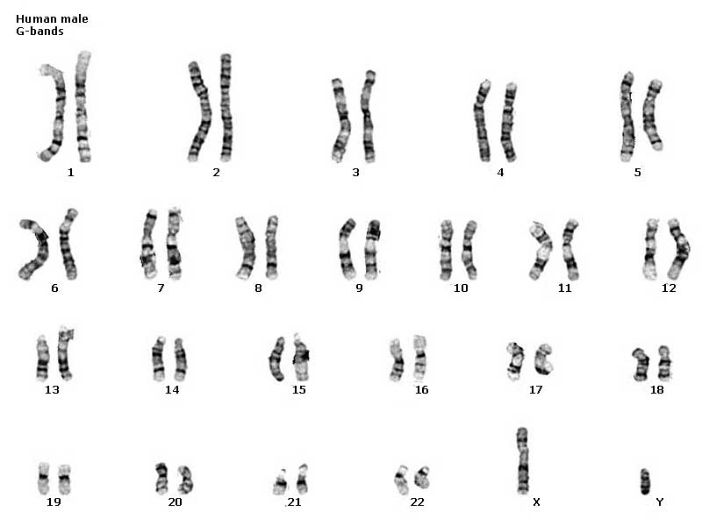
Classes of chromosomes
autosomal
chromosomes
sex
chromosomes

Slide 11
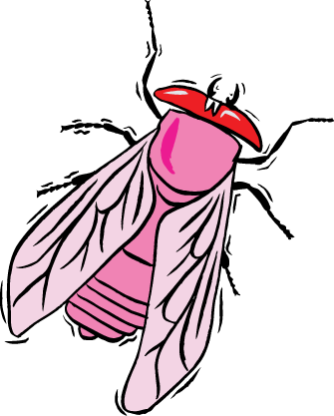


Discovery of sex linkage
true-breeding
red-eye female
true-breeding
white-eye male
P
X
Huh!
Sex matters?!
100%
red eye offspring
F₁
generation
(hybrids)
100%
red-eye female
50% red-eye male
50% white eye male
F₂
generation

Slide 12


What we expected…
x
x
RR
rr
Rr
Rr
F₁ breeds…
r
r
R
r
R
Rr
Rr
But it doesn’t work
that way!
R
RR
Rr
R
Rr
Rr
r
Rr
rr
100% red eyes
3 red : 1 white

Slide 13
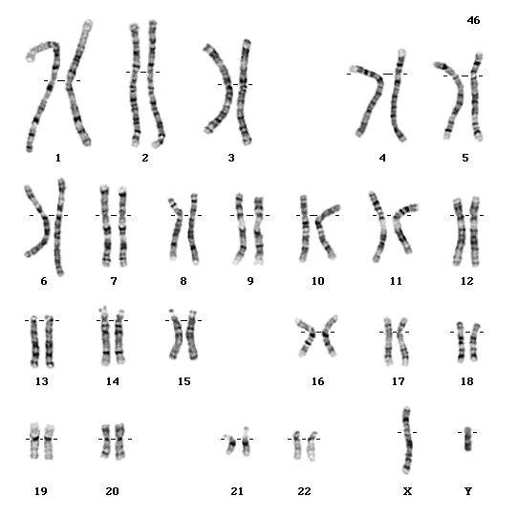
Genetics of Sex
In humans & other mammals, there are 2 sex chromosomes: X & Y
  2 X chromosomes
    develop as a female: XX
    Have an “extra” X chromosome
  an X & Y chromosome
    develop as a male: XY
    no “extra” X
X
Y
X
XX
XY
50% female : 50% male
X
XX
XY

Slide 14



Let’s reconsider Morgan’s flies…
x
x
X^{R}X^{R}
X^{r}Y
X^{R}X^{r}
X^{R}Y
F₁ breeds…
X^{r}
Y
X^{R}
Y
X^{R}
X^{R}
X^{R}X^{r}
X^{R}Y
BINGO!
X^{R}X^{R}
X^{R}Y
X^{R}
X^{r}
X^{R}X^{r}
X^{R}Y
X^{R}X^{r}
X^{r}Y
100% red eyes
100% red females
50% red males; 50% white males

Slide 15
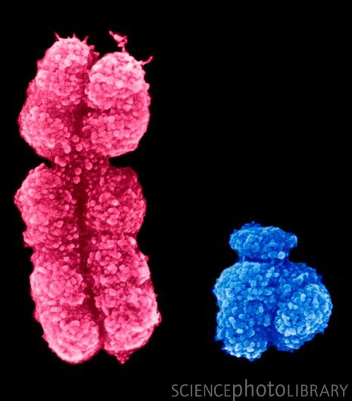
Genes on sex chromosomes
Y chromosome
  Very few genes
    Only genes for “maleness”
X chromosome
  Not just “female”—other genes too!
    Mutations in genes can cause diseases
Notes:
Duchenne muscular dystrophy affects one in 3,500 males born in the United States.
Affected individuals rarely live past their early 20s.
This disorder is due to the absence of an X-linked gene for a key muscle protein, called dystrophin.
The disease is characterized by a progressive weakening of the muscles and loss of coordination.

Slide 16
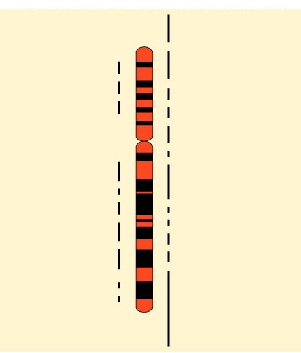
Human X chromosome
Ichthyosis, X-linked
Placental steroid sulfatase deficiency
Kallmann syndrome
Chondrodysplasia punctata,
X-linked recessive
Sex-linked
  usually means
  “X-linked”
  more than
  60 diseases traced to genes on X chromosome
Hypophosphatemia
Aicardi syndrome
Hypomagnesemia, X-linked
Ocular albinism
Retinoschisis
Duchenne muscular dystrophy
Becker muscular dystrophy
Chronic granulomatous disease
Retinitis pigmentosa-3
Adrenal hypoplasia
Glycerol kinase deficiency
Norrie disease
Retinitis pigmentosa-2
Ornithine transcarbamylase
deficiency
Incontinentia pigmenti
Wiskott-Aldrich syndrome
Menkes syndrome
Sideroblastic anemia
Aarskog-Scott syndrome
PGK deficiency hemolytic anemia
Androgen insensitivity
Charcot-Marie-Tooth neuropathy
Choroideremia
Cleft palate, X-linked
Spastic paraplegia, X-linked,
uncomplicated
Deafness with stapes fixation
Anhidrotic ectodermal dysplasia
Agammaglobulinemia
Kennedy disease
PRPS-related gout
Pelizaeus-Merzbacher disease
Alport syndrome
Fabry disease
Lowe syndrome
Lesch-Nyhan syndrome
HPRT-related gout
Immunodeficiency, X-linked,
with hyper IgM
Lymphoproliferative syndrome
Hunter syndrome
Hemophilia B
Hemophilia A
G6PD deficiency: favism
Drug-sensitive anemia
Chronic hemolytic anemia
Manic-depressive illness, X-linked
Colorblindness, (several forms)
Dyskeratosis congenita
TKCR syndrome
Adrenoleukodystrophy
Adrenomyeloneuropathy
Emery-Dreifuss muscular dystrophy
Diabetes insipidus, renal
Myotubular myopathy, X-linked
Albinism-deafness syndrome
Fragile-X syndrome

Slide 17
Hemophilia
sex-linked recessive
X^{H}X^{h}
X^{H}Y
Hh x HH
X^{H}
male / sperm
X^{H}X^{h}
X^{H}
Y
X^{h}
X^{H}Y
X^{H}X^{H}
X^{H}Y
X^{H}
X^{H}X^{H}
X^{H}
female / eggs
X^{H}Y
X^{h}
X^{h}Y
X^{H}X^{h}
X^{h}Y
X^{H}X^{h}
Y
carrier
disease

Slide 18
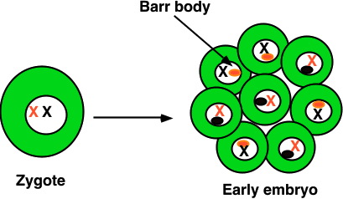
X-inactivation
Female mammals inherit 2 X chromosomes
  one X becomes inactivated during embryonic development
    condenses into compact object = Barr body
    which X becomes Barr body is random
      patchwork trait = “mosaic”
patches of black
X^{H}
X^{H}X^{h}
tricolor cats
can only be
female
X^{h}
patches of orange

Slide 19
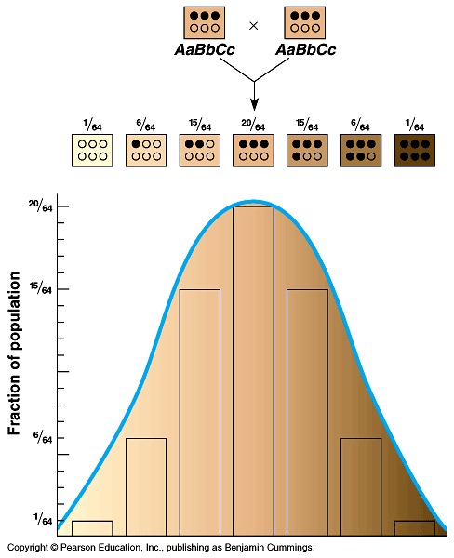
Polygenic inheritance
Some phenotypes determined by additive effects of 2 or more genes on a single characteristic
  phenotypes on a continuum
  human traits
    skin color
    height
    weight
    intelligence
    behaviors
6 genes for skin color

Slide 20
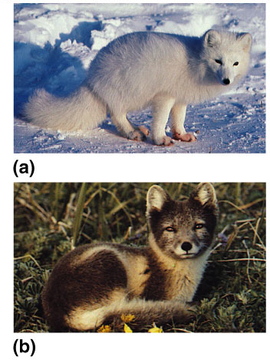
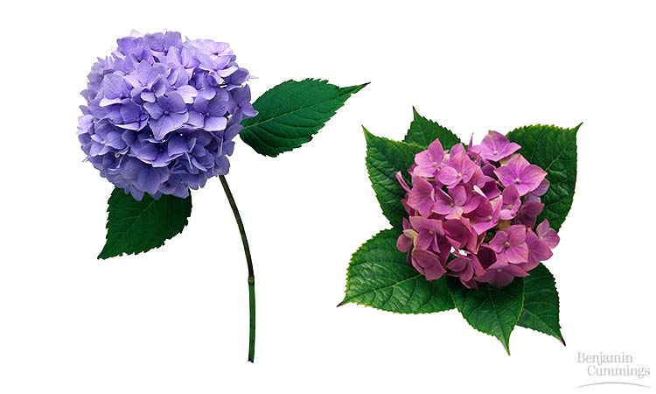

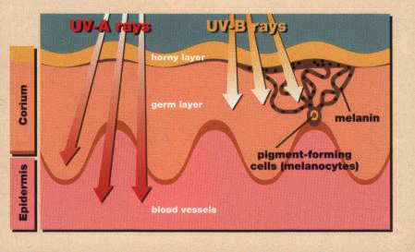
Multifactorial
Phenotype is controlled by both environment & genes
Human skin color is influenced by both genetics & environmental conditions
Coat color in arctic fox influenced by heat sensitive alleles
Color of Hydrangea flowers is influenced by soil pH
Notes:
The relative importance of genes & the environment in influencing human characteristics is a very old & hotly contested debate
a single tree has leaves that vary in size, shape & color, depending on exposure to wind & sun
for humans, nutrition influences height, exercise alters build, sun-tanning darkens the skin, and experience improves performance on intelligence tests
even identical twins — genetic equals — accumulate phenotypic differences as a result of their unique experiences

