Slide 1
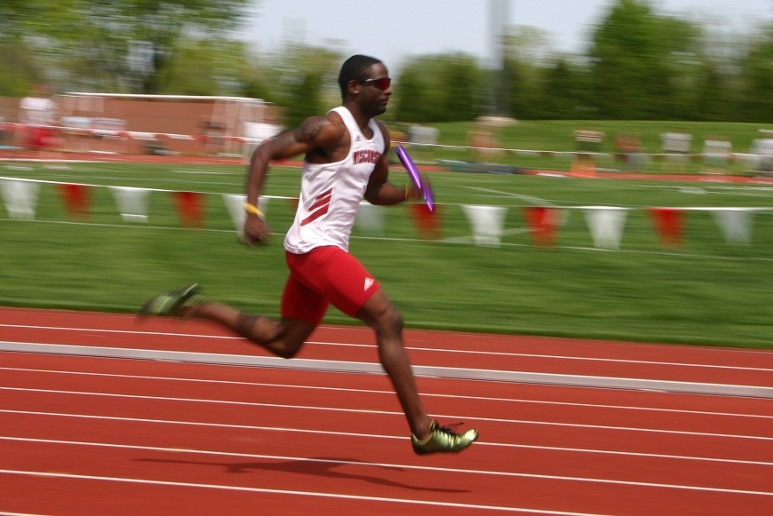
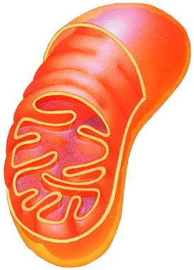
Cellular Respiration
ATP
Burning sugar for energy

Slide 2
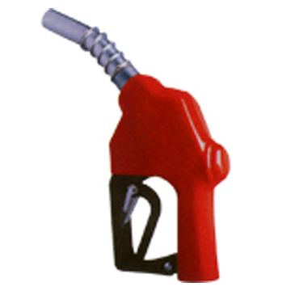
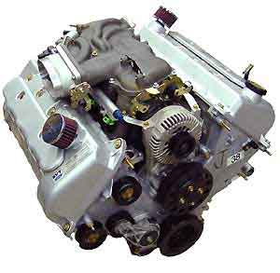
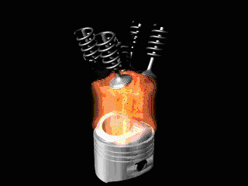
What is cellular respiration for?
Energy from sugar…
  Like burning gas in an engine
+
Glucose
Mitochondria
ATP

Slide 3
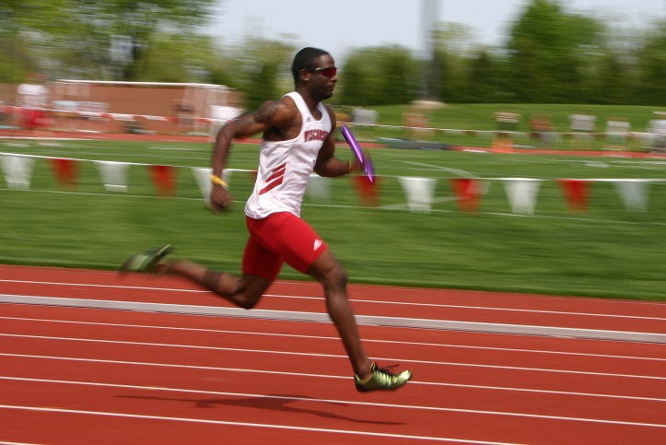
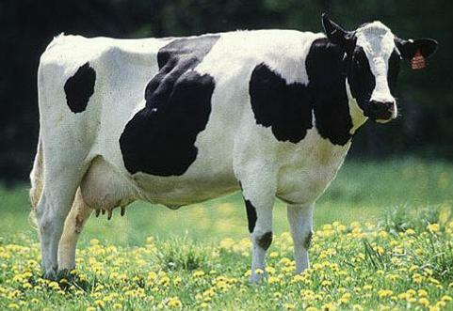
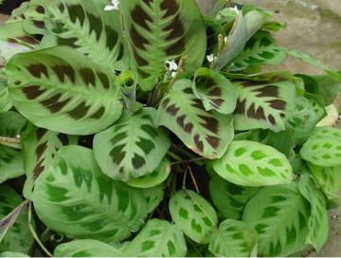
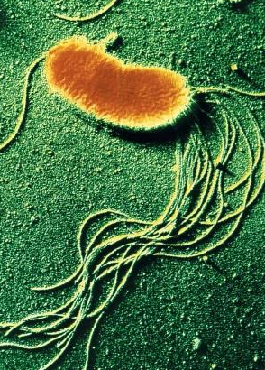
What organisms use cellular respiration?
All of them!
  Eukaryotes
    Including plants!!
    Have mitochondria
  Prokaryotes
    NO mitochondria

Slide 4
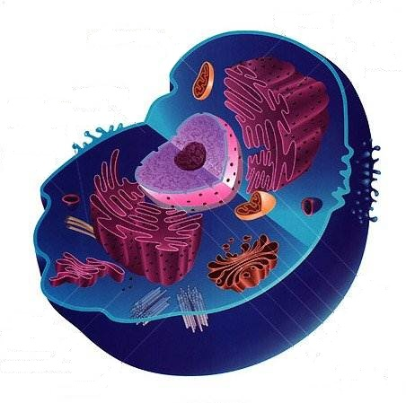
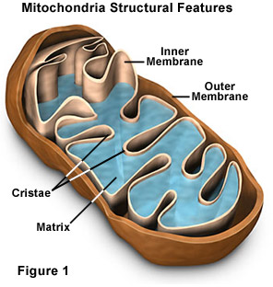
Where does cellular respiration happen?
Begins in the cytosol…
Cristae
Matrix
…finishes in the mitochondria

Slide 5
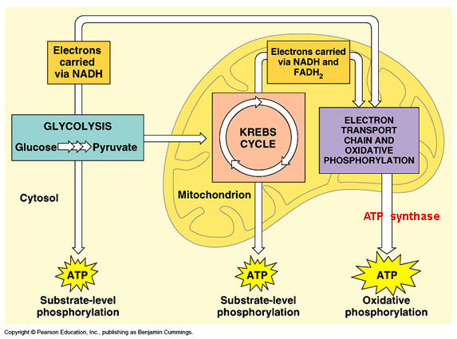
How does it work?
Glycolysis
Krebs Cycle
Electron Transport Chain

Slide 6
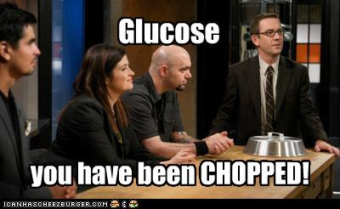
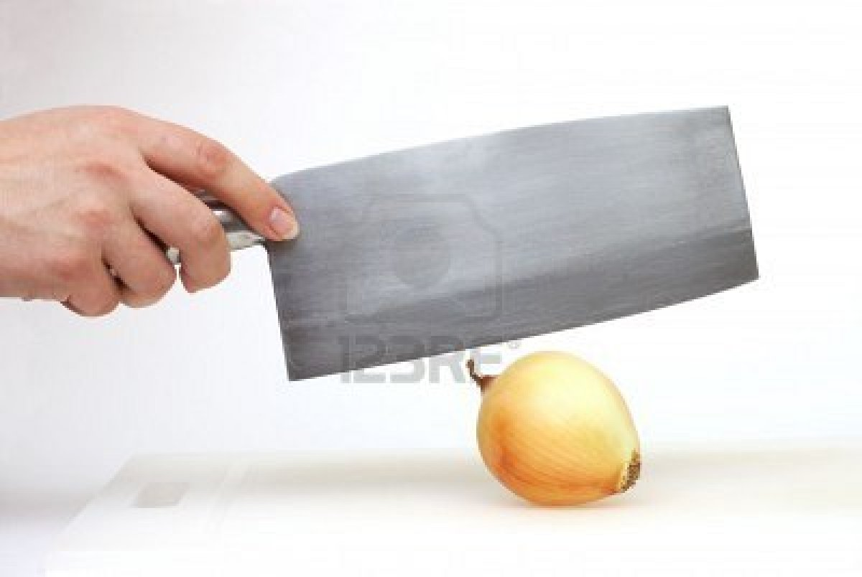
Stage 1: Glycolysis
Occurs in cytosol
Glucose chopped into 2 pyruvate
Uses 2 ATP
Makes 4 ATP and 2 NADH (an electron acceptor)
  (Net 2 ATP)
Glucose
Pyruvate
Pyruvate

Slide 7
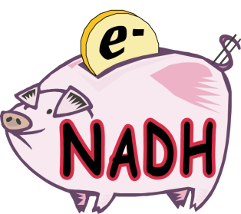
Summary of glycolysis
2
+
2
+
Glucose
ATP
Pyruvate
2
Power for the cell
With oxygen: to the mitochondria!
Without oxygen: fermentation (coming soon…)
Occurs in the cytosol

Slide 8
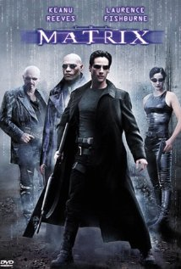
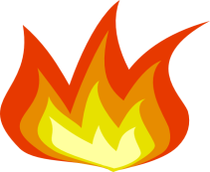
Stage 2: Krebs Cycle
Occurs in the matrix
Needs TWO “turns” for each glucose
First pyruvate is converted to acetyl CoA
Acetyl-CoA burned into:
  4 CO₂ (waste)
  2 ATP ($)
  6 NADH
  2 FADH₂
Acetyl-CoA
Euros €
(electron acceptors)

Slide 9


CO₂
pyruvate
3C
2C
acetyl CoA
NADH
NADH
4C
6C
This happens twice for each glucose molecule
4C
6C
x2
CO₂
5C
NADH
4C
FADH₂
CO₂
4C
4C
ATP
NADH

Slide 10
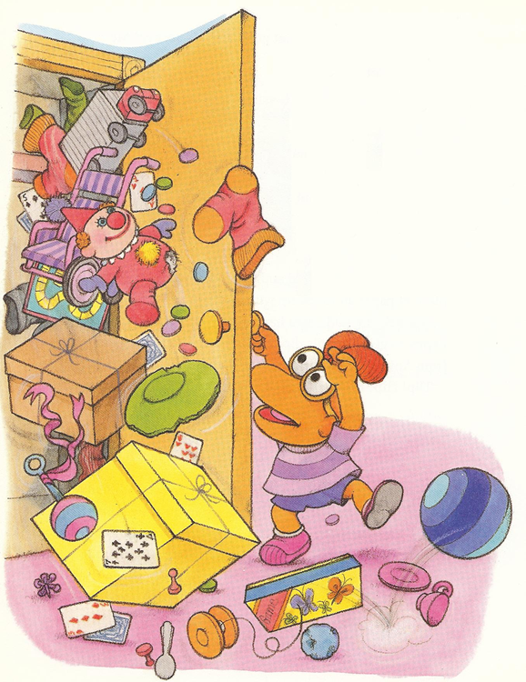
Stage 3: Electron transport chain
Occurs in the cristae
Powered by electrons from NADH and FADH₂
Electron transport chain creates H⁺ concentration gradient
ATP synthase creates ATP through chemiosmosis
Overall: Euros (electron acceptors) converted to dollars (ATP)

Slide 11
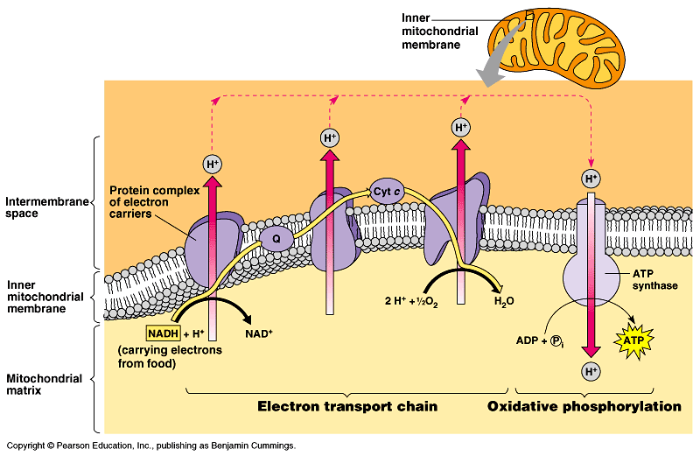
Cristae
H⁺
H⁺
H⁺
H⁺
e⁻
ATP Synthase
e⁻
e⁻
H₂O
NADH & FADH₂
NAD⁺ & FAD
ATP
H⁺

Slide 12
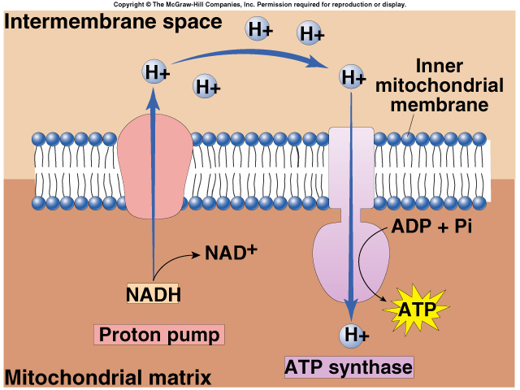
ETC Summary
O₂ final electron acceptor → H₂O
Reactants
  All NADH and FADH₂ from previous stages
  Oxygen
Products (per glucose)
  Water
  ~34 ATP

Slide 13
Overall cellular respiration reaction
O₂
Water
(H₂O)
CO₂
Glucose
+
ATP
+
+

Slide 14
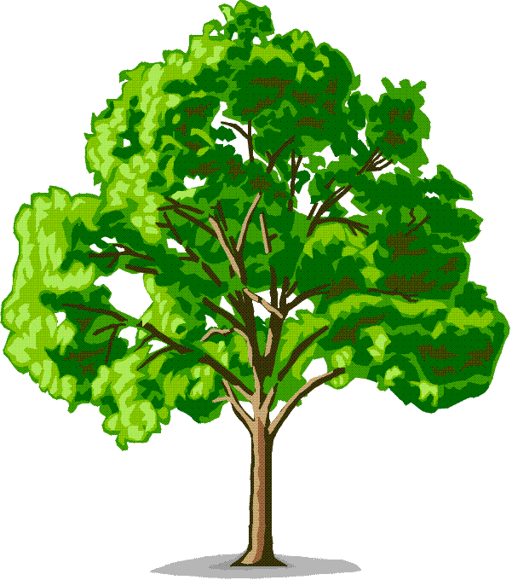
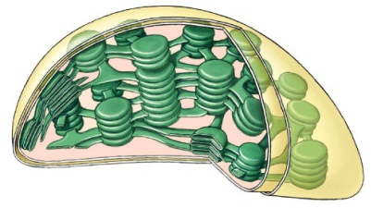
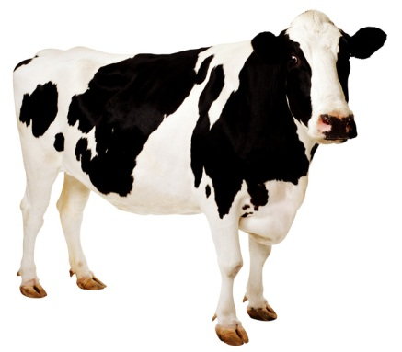
Overall photosynthesis/respiration cycle

