Slide 1
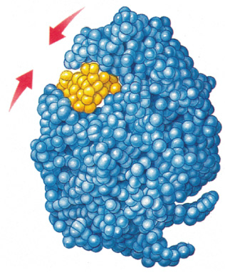
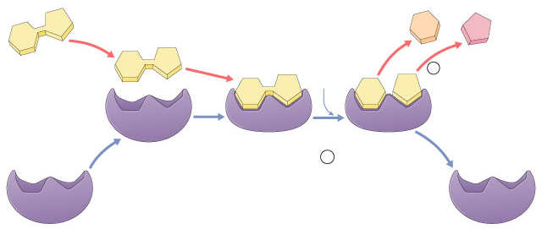
Enzymes:
They do all the work!

Slide 2
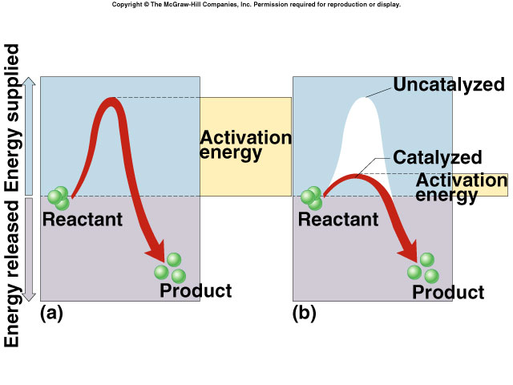
Enzymes
Proteins
Help chemical reactions happen
  reduce activation energy
  increase rate of reaction without being used up
Required for most biological reactions
Very specific
  thousands of different enzymes in cells!

Slide 3
Enzymes
Enzymes are proteins that act as biological catalysts.
Cells use enzymes to speed up chemical reactions that take place in cells.
Enzyme speed up reactions by lowering the activation energies.
Because a particular enzyme catalyzes only one reaction, there are thousands of different enzymes in a cell catalyzing thousands of different chemical reactions

Slide 4
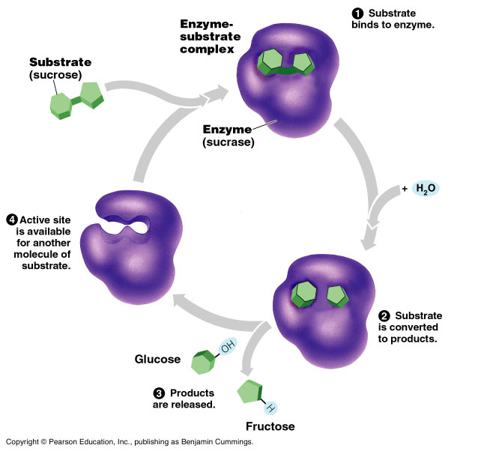

Slide 5
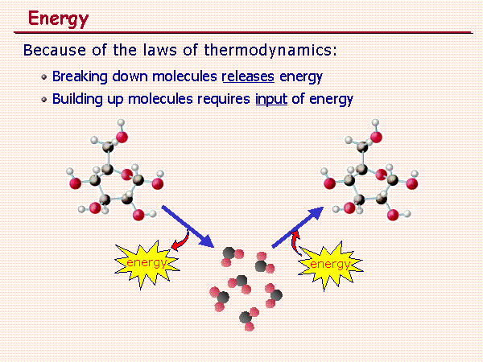
Energy In Reactions
Energy is released or absorbed whenever chemical bonds are formed or broken.
Because chemical reactions involve breaking and forming of bonds, they involve changes in energy.

Slide 6
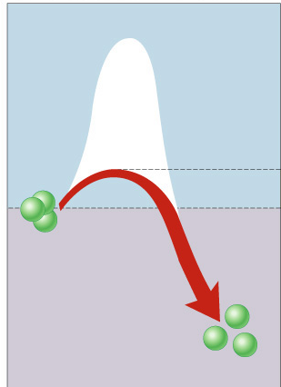
What do enzymes do?
Catalysts
  reduce the amount of energy needed to
  start a reaction
  They are not used up in the reaction
uncatalyzed reaction
Pheeew…
that takes a lot
less energy!
catalyzed reaction
NEW activation energy
reactant
product

Slide 7
Enzymes vocabulary
substrate
    reactant which binds to enzyme
active site
    enzyme’s catalytic site
    substrate fits into active site
product
    end result of reaction
active site
product
substrate
enzyme

Slide 8
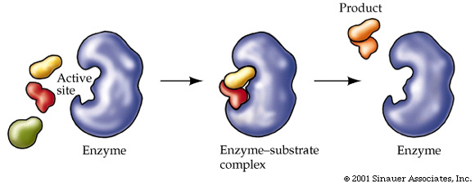
All enzymes have an active site, where substrates are attracted to.
Enzymes are used over and over again.

Slide 9
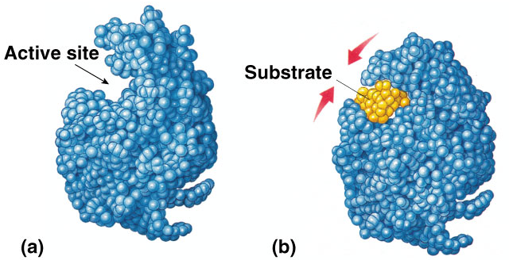
How do they work?
Induced fit model
  3-D structure of enzyme fits substrate
  substrate binding causes enzyme to change shape leading to a tighter fit

Slide 10
Naming conventions
Enzymes named for reaction they catalyze– end in -ase
  sucrase breaks down sucrose
  protease breaks down proteins
  lipase breaks down lipids
  DNA polymerase builds
  DNA (a polymer)
  pepsin breaks down
  proteins (polypeptides)

Slide 11
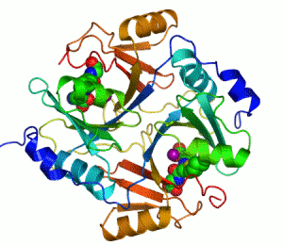
What affects enzymes?
Enzyme concentration
Substrate concentration
Temperature
pH
Activators
Inhibitors
Notes:
Living with oxygen is dangerous. We rely on oxygen to power our cells, but oxygen is a reactive molecule that can cause serious problems if not carefully controlled. One of the dangers of oxygen is that it is easily converted into other reactive compounds. Inside our cells, electrons are continually shuttled from site to site by carrier molecules, such as carriers derived from riboflavin and niacin. If oxygen runs into one of these carrier molecules, the electron may be accidentally transferred to it. This converts oxygen into dangerous compounds such as superoxide radicals and hydrogen peroxide, which can attack the delicate sulfur atoms and metal ions in proteins. To make things even worse, free iron ions in the cell occasionally convert hydrogen peroxide into hydroxyl radicals. These deadly molecules attack and mutate DNA. Fortunately, cells make a variety of antioxidant enzymes to fight the dangerous side-effects of life with oxygen. Two important players are superoxide dismutase, which converts superoxide radicals into hydrogen peroxide, and catalase, which converts hydrogen peroxide into water and oxygen gas. The importance of these enzymes is demonstrated by their prevalence, ranging from about 0.1% of the protein in an E. coli cell to upwards of a quarter of the protein in susceptible cell types. These many catalase molecules patrol the cell, counteracting the steady production of hydrogen peroxide and keeping it at a safe level. Catalases are some of the most efficient enzymes found in cells. Each catalase molecule can decompose millions of hydrogen peroxide molecules every second. The cow catalase shown here and our own catalases use an iron ion to assist in this speedy reaction. The enzyme is composed of four identical subunits, each with its own active site buried deep inside. The iron ion, shown in green, is gripped at the center of a disk-shaped heme group. Catalases, since they must fight against reactive molecules, are also unusually stable enzymes. Notice how the four chains interweave, locking the entire complex into the proper shape.

Slide 12
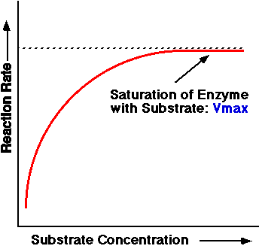
Amount Of Substrate Present
At low substrate concentrations, collisions between enzymes and substrate molecules are rare and reactions are slow.
As the amount of substrates increase so does the collisions between enzymes and substrates.
This continues until the enzymes are saturated.

Slide 13
Enzyme concentration
as ↑ enzyme = ↑ reaction rate
  more enzymes = more frequently collide with substrate
reaction rate levels off
  substrate becomes limiting factor
  not all enzyme molecules can find substrate
reaction rate
enzyme concentration
Notes:
Why is it a good adaptation to organize the cell in organelles?
Sequester enzymes with their substrates!

Slide 14
Substrate concentration
as ↑ substrate = ↑ reaction rate
  more substrate = more frequently collide with enzyme
reaction rate levels off
  all enzymes have active site engaged
  maximum rate of reaction
reaction rate
substrate concentration
Notes:
Why is it a good adaptation to organize the cell in organelles?
Sequester enzymes with their substrates!

Slide 15
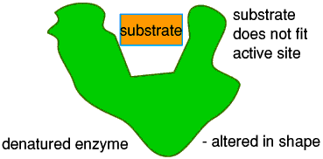
Affects of temperature on an enzyme
If temp to high or to low the enzyme will not fit. No reaction will occur.

Slide 16
Enzymes and temperature
Different enzymes function in different organisms in different environments
hot spring
bacteria enzyme
human enzyme
reaction rate
37°C
70°C
temperature
(158°F)

Slide 17
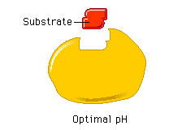
How pH affects an enzyme
If the pH is to high or low the enzyme will not work, because its shape will change.
All enzymes have an optimum pH that they function best at.
If the pH is to low or to high the enzyme will work slow because the change in pH changes the shape of the enzyme making it harder for the substrate to fit in.

Slide 18
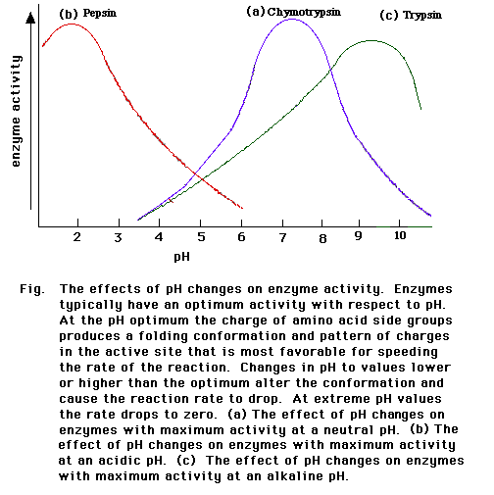
Analyze the graph at what pH does Chymotrypsin function best?

Slide 19
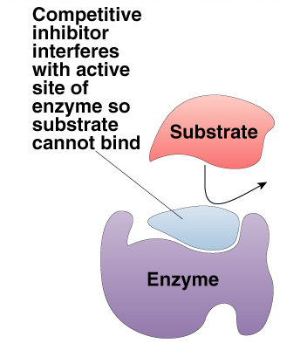
Competitive Inhibitor
Inhibitor & substrate “compete” for active site
  Slows down reaction
  Example: penicillin
    blocks enzyme bacteria use to build cell walls
Notes:
Ethanol is metabolized in the body by oxidation to acetaldehyde, which is in turn further oxidized to acetic acid by aldehyde oxidase enzymes. Normally, the second reaction is rapid so that acetaldehyde does not accumulate in the body.
A drug, disulfiram (Antabuse) inhibits the aldehyde oxidase which causes the accumulation of acetaldehyde with subsequent unpleasant side-effects of nausea and vomiting. This drug is sometimes used to help people overcome the drinking habit.
Methanol (wood alcohol) poisoning occurs because methanol is oxidized to formaldehyde and formic acid which attack the optic nerve causing blindness. Ethanol is given as an antidote for methanol poisoning because ethanol competitively inhibits the oxidation of methanol. Ethanol is oxidized in preference to methanol and consequently, the oxidation of methanol is slowed down so that the toxic by-products do not have a chance to accumulate.

