Slide 1


Evidence for Evolution by
Natural Selection
Hunting for evolution clues… Elementary, my dear Darwin!

Slide 2
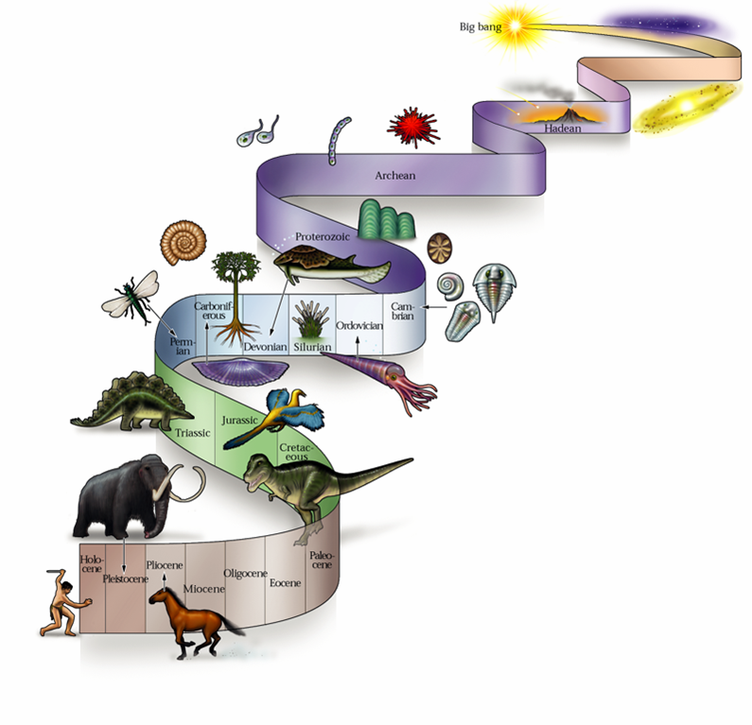
Evidence supporting evolution
Fossil record
  shows change over time
Anatomical record
  comparing body structures
Molecular record
  comparing protein & DNA sequences
Artificial selection
  human caused evolution

Slide 3
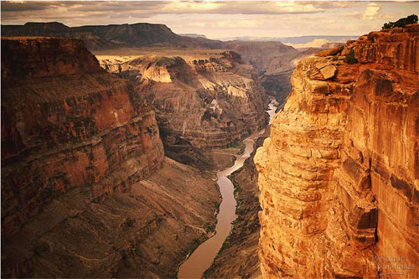
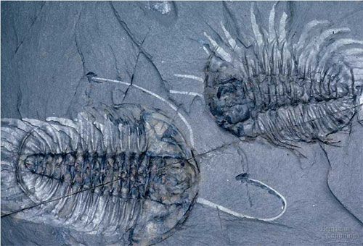
1. Fossil record (fossil = “dug up”)
Layers of rock contain fossils
  Bones, shells, tracks, impressions, etc.
  New layers cover older ones
Show a series of organisms have lived on Earth
  Over billions of years

Slide 4

Dating Fossils
Absolute dating
  Use radioactive isotopes to determine age
    Carbon dating can tell us when a living thing died
    Uranium dating can tell us when rock came out of a volcano
Relative dating
  Use other objects
  around a fossil to
  approximate age

Slide 5
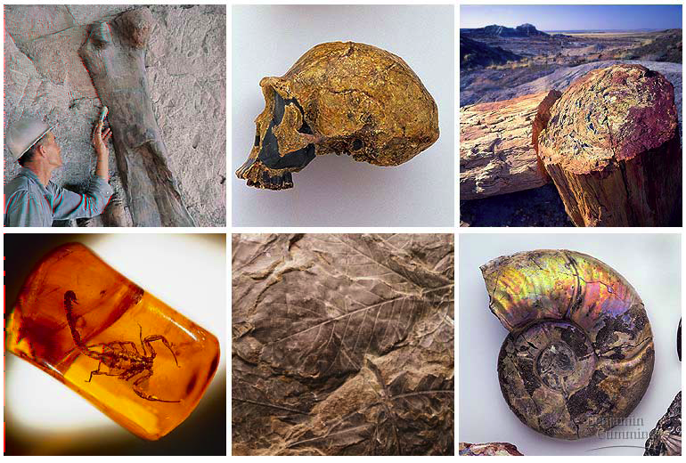
Fossils tell a story…
the Earth is old
Life is old
Life on Earth has changed

Slide 6
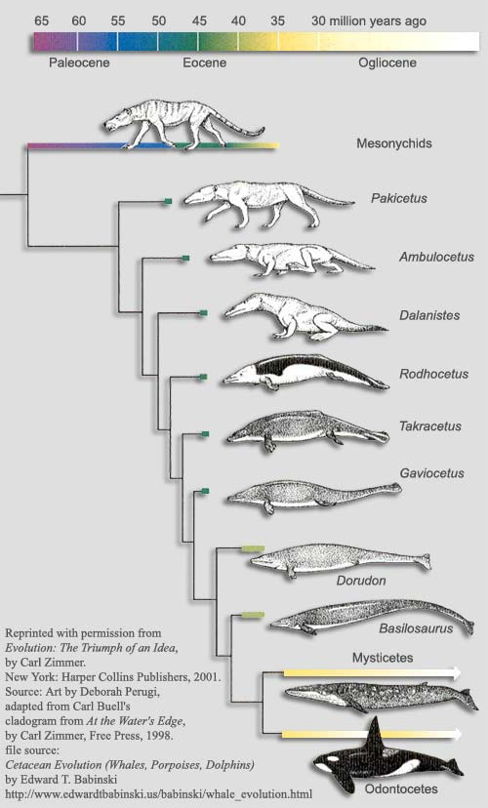
The story of whales…
Land Mammal
?
?
?
?
Ocean Mammal
Notes:
There are innumerable intermediate & transitional forms
Whales as land creatures returning to the water….
Where are the intermediate forms of whale ancestors?
Cartoon making fun of this idea.
The cartoons disappeared 10-12 years ago when this fossil was found.
Ambilocetic natans = “Walking whale who likes to swim”
4-5 intermediate forms all found in last 2 decades
Indus River valley in between India & Pakistan.

Slide 7
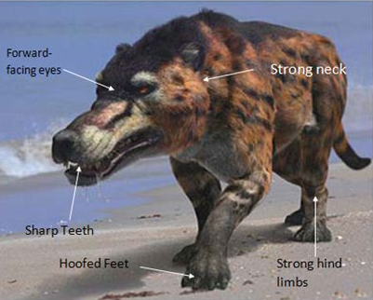
Mesonychids (or artiodactyls?)
Lived: ~56 million years ago
Lived near water but could not swim
First fossils discovered: 1983

Slide 8
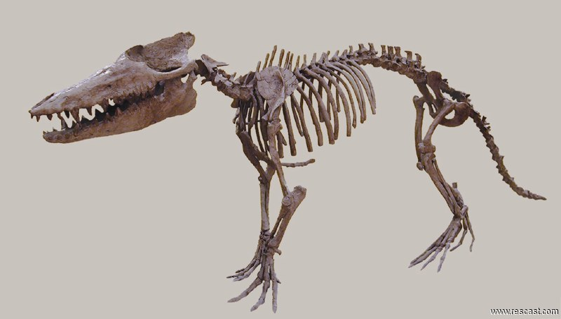
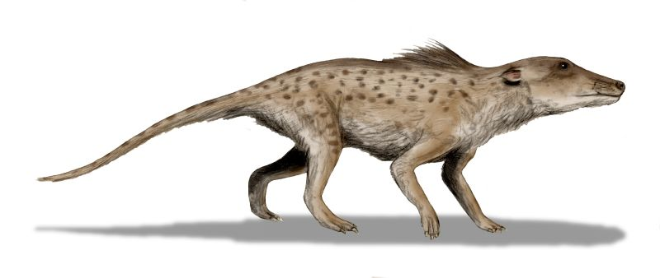
Pakicetus
Lived: ~50 million years ago
First definite whale ancestor
  Lived near rivers but did not swim
  Ear bones similar to modern whales
First fossils discovered: 1983 (not complete until 2001)

Slide 9
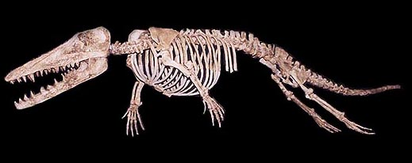
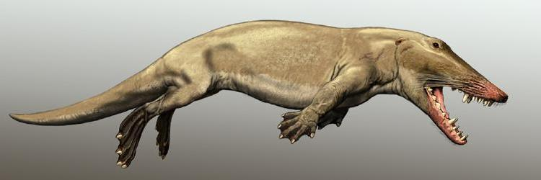
Ambulocetus
Lived: ~49 million years ago
Amphibious (lived on land AND in water)
  Webbed limbs
  Found near both fresh and salt water
First fossils discovered: 1993

Slide 10
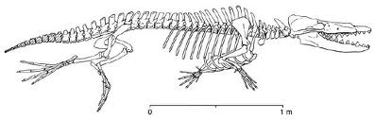
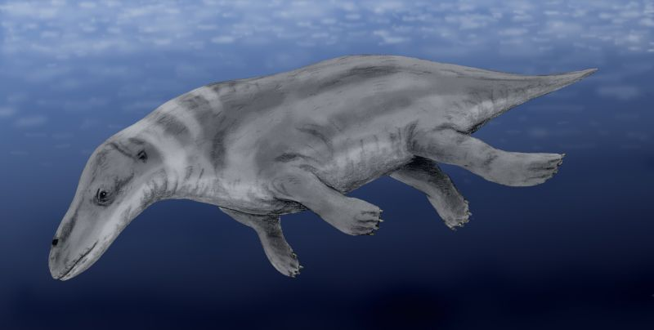
Rhodocetus
Lived: ~47 million years ago
Lived in shallow waters
  Webbed limbs
  Strong tail probably used in swimming
First fossils discovered: 2001

Slide 11
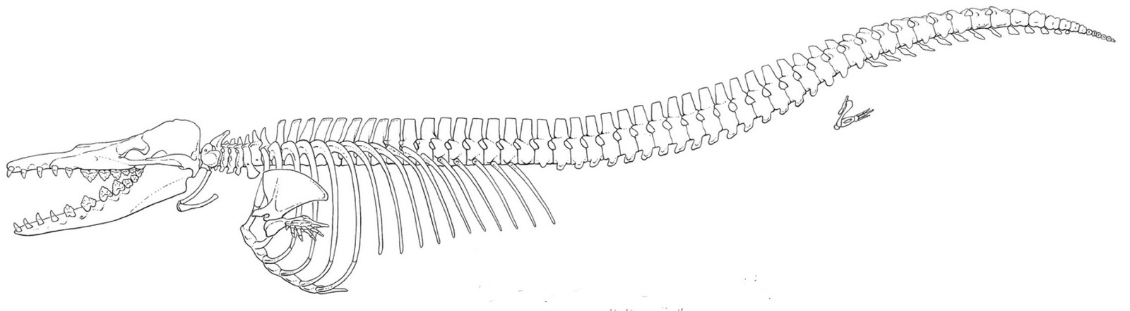
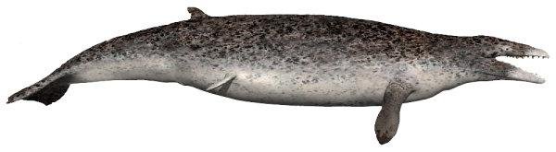
Dorudon
Lived: ~41 million years ago
Aquatic (lived in ocean)
  First “whales”
  Skull, teeth, and ears like modern whales
First fossils discovered: 1845

Slide 12
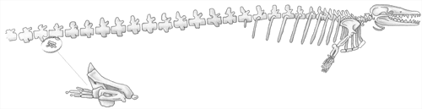
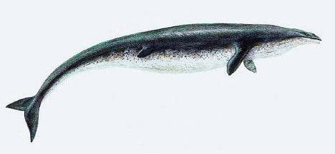
Basilosaurus
Lived: ~40 million years ago
Lived in ocean
  Very similar to Dorudon
  Bone structure suggests it could only swim near the surface
  Small, useless hind limbs
First fossils discovered: 1843

Slide 13
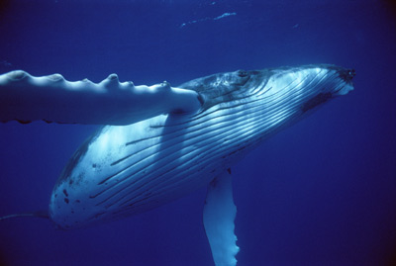
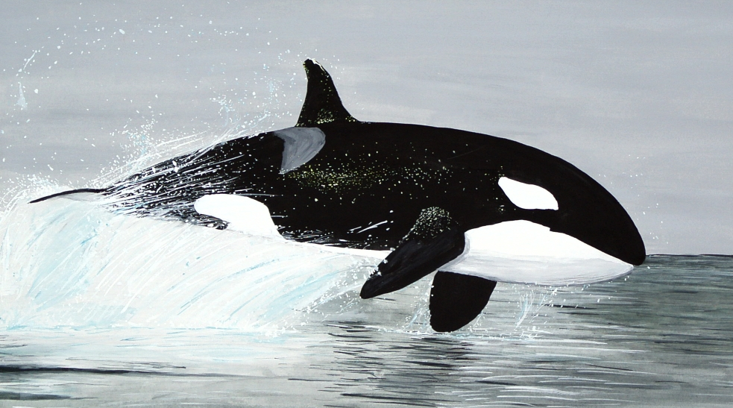
Modern whales
First modern toothed whales appear ~20 million years ago
First modern baleen whales appear ~15 million years ago

Slide 14
The whole story…

Slide 15

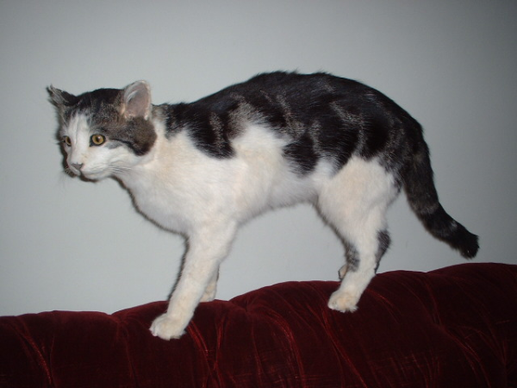
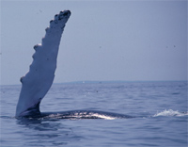
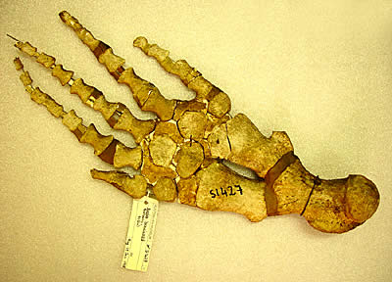
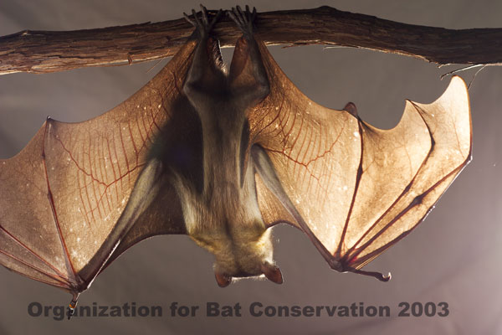
2. Anatomical record
Animals with different structures on the surface
But when you look under the skin…
It tells an evolutionary story of common ancestors

Slide 16
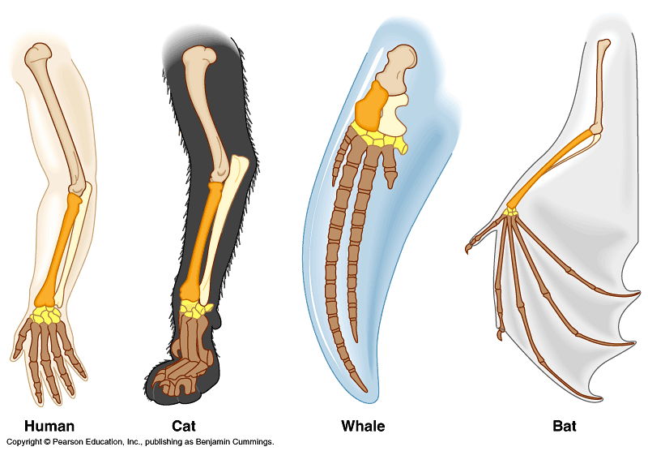
Homologous structures
Structures that come from the same origin
    homo- = same -logous = information
Forelimbs of human, cats, whales, & bats
  same structure
    on the inside
  same development
  in embryo
  different functions
    on the outside
  evidence of
  common ancestor

Slide 17
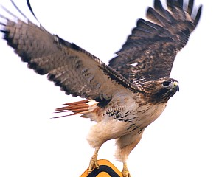
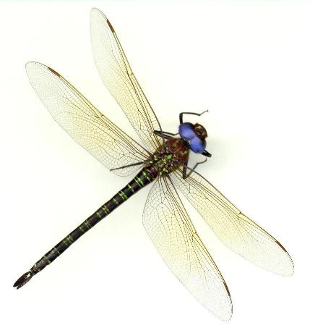
But don’t be fooled by these…
Analogous structures
  look similar
    on the outside
  same function
  different structure &
  development
    on the inside
  different origin
    Developed because of
    similar selection pressure
How is a bird
like a bug?
Solving a similar problem with a similar solution

Slide 18
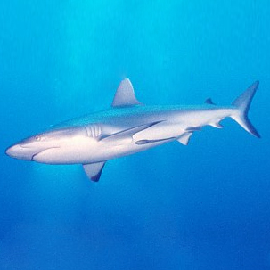
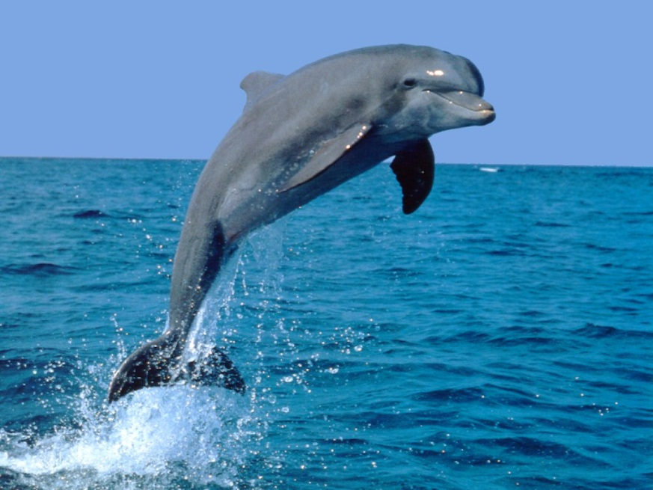
Analogous structures
Dolphins: aquatic mammal
Sharks: aquatic cartilaginous fish
  both adapted to
  life in the sea
  not closely related

Slide 19
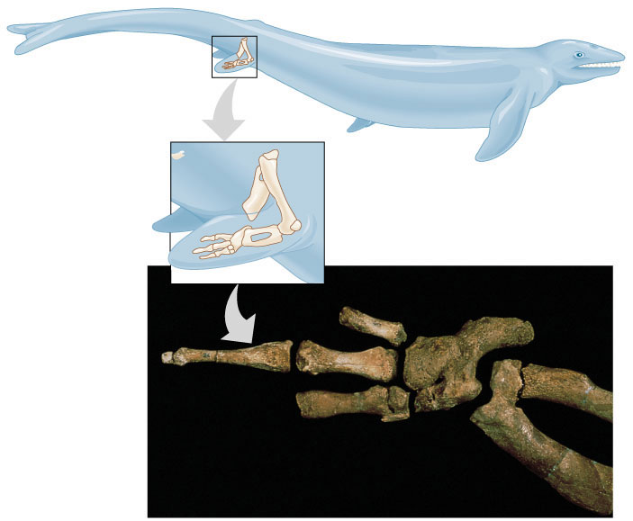
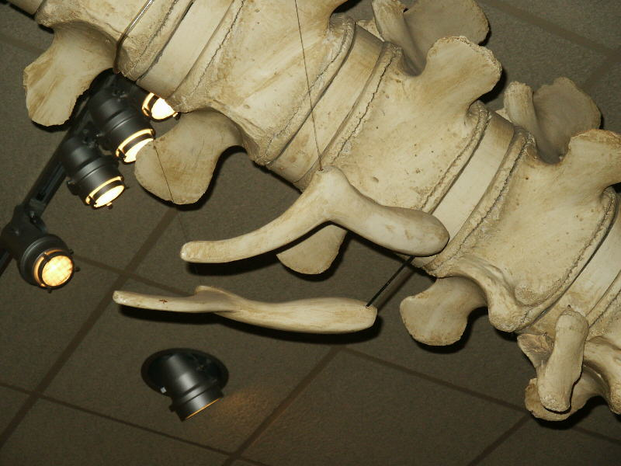
Vestigial structures
Evolutionary “leftovers”
  Hind leg bones on whale fossils
  Vestigial pelvis bones on modern whales

Slide 20
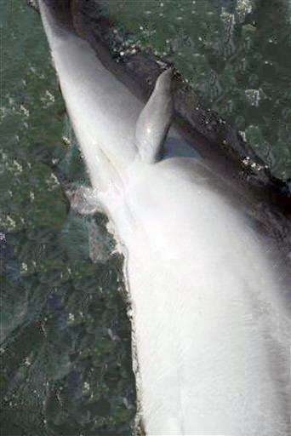
Bottlenose dolphin mutation
Dolphin caught in 2006 had two hind limbs
Possible re-emergence (through mutation) of a vestigial trait

Slide 21
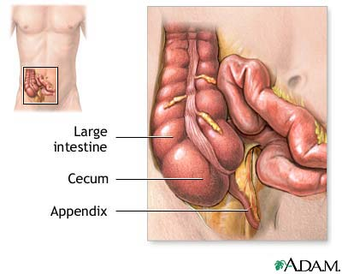
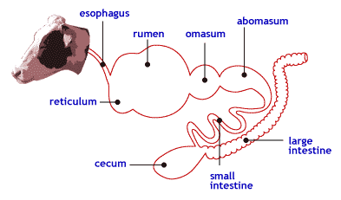
Vestigial traits in humans
Humans have vestigial traits too!
The appendix
  vestigial form of the cecum
    Still have a cecum, but it is smaller
  herbivores use the cecum to digest plant fiber (cellulose)

Slide 22
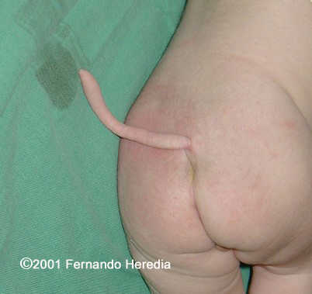
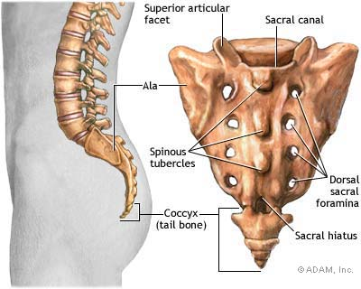
Human vestigial traits cont.
All humans have a tailbone (coccyx)
  rarely someone is born with a vestigial tail

Slide 23
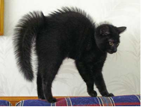

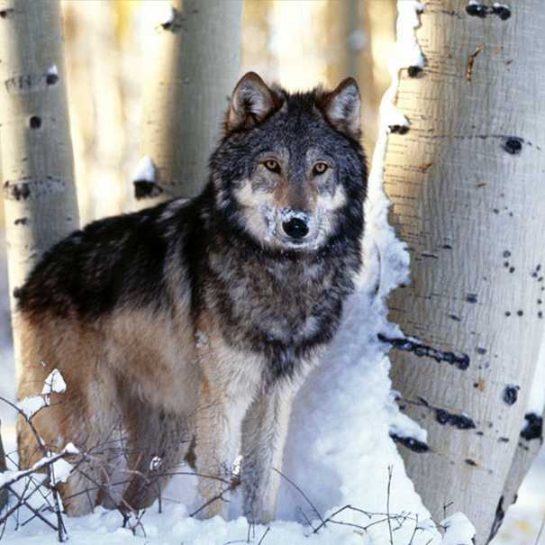
Human vestigial traits cont.
The goosebump response
  Remains from a time when we had thicker fur
  Could stand hair on end to frighten predators or insulate from the cold

Slide 24
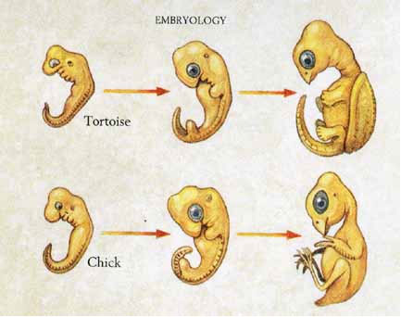
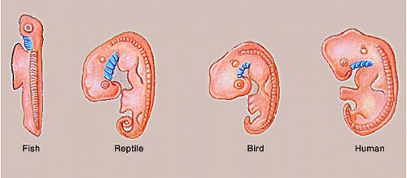
Comparative embryology
Development of embryo tells an evolutionary story
  similar structures during development
all vertebrate embryos have a “gill pouch” at one stage of development

Slide 25
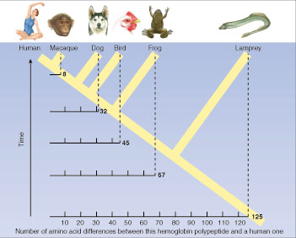
3. Molecular record
Comparing nucleic acid & protein structure
  everyone uses the same code!
    DNA & RNA (nucleotides)
    Proteins (amino acids)
compare common genes
compare common proteins
number of amino acids different from human hemoglobin

Slide 26
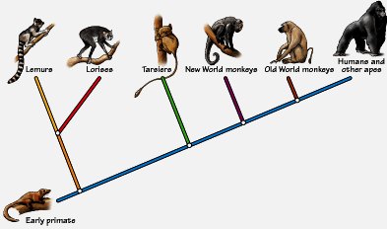
Building “family” trees
Closely related species are branches on the tree (called a cladogram) — coming from a common ancestor
Common ancestor is now extinct

Slide 27
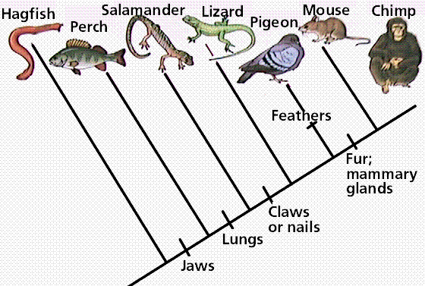
More on cladograms
Derived structures

Slide 28
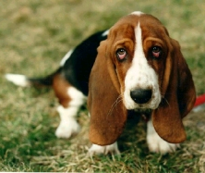
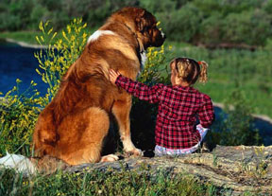
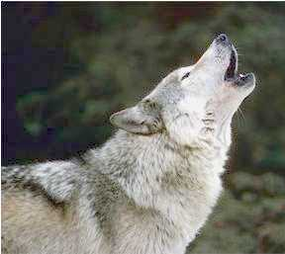
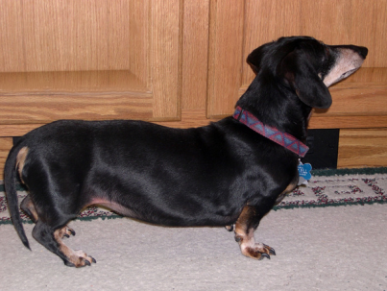
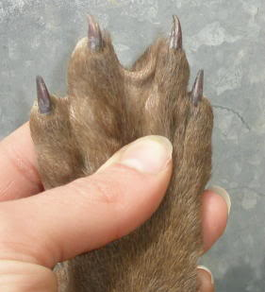
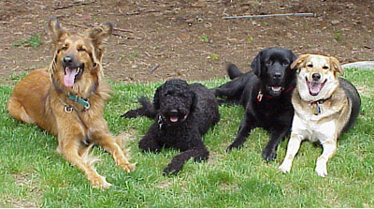
4. Artificial selection
How do we know selection can change a population?
  we do it all the time!
  “evolution by human selection”
“descendants” of the wolf

Slide 29
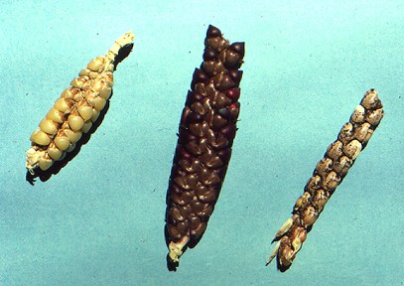
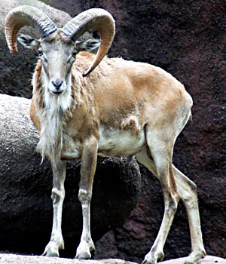
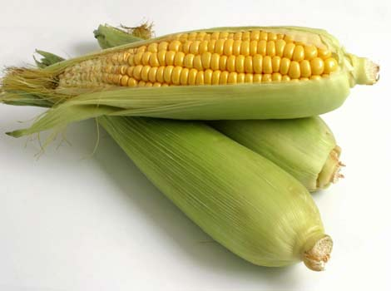

More examples of artificial selection
Agricultural crops
Farm animals

Slide 30

Artificial Selection gone bad!
Sometimes we don’t do it on purpose…
  Pesticide resistance
  Antibiotic resistance
Some “superbugs” that are resistant to most antibiotics:
MRSA (Staph infection)
Tuberculosis

Slide 31

How resistance develops
Spray the field or give the antibiotic, but…
  Didn’t kill all individuals
    variation
  Resistant survivors reproduce
  Resistance is inherited
  Resistance becomes more common
Notes:
The evolution of resistance to insecticides in hundreds of insect species is a classic example of natural selection in action.
The results of application of new insecticide are typically encouraging, killing 99% of the insects.
However, the effectiveness of the insecticide becomes less effective in subsequent applications. The few survivors from the early applications of the insecticide are those insects with genes that enable them to resist the chemical attack. Only these resistant individuals reproduce, passing on their resistance to their offspring. In each generation the % of insecticide-resistant individuals increases.

