Slide 1
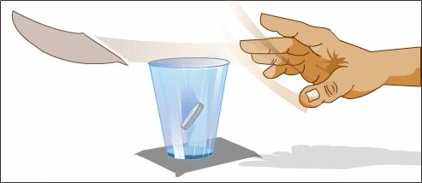

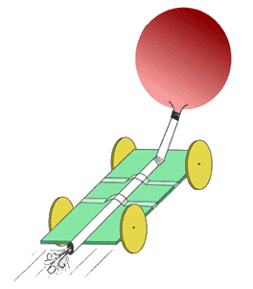
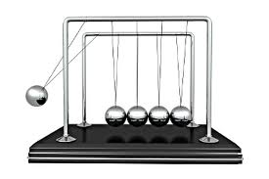
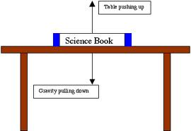
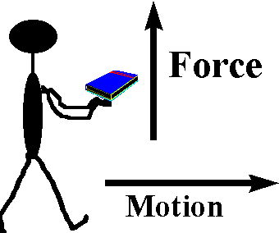
Force and Motion Review

Slide 2
A force is simply a push or a pull.
All forces have both size and direction.

Slide 3
Watch….
https://www.youtube.com/watch?v=8iKhLGK7HGk&t=2s

Slide 4


NET FORCES
When two or more forces are combined!

Slide 5

Some tips:
Forces in the same direction- add the two forces together.
+ =
Forces in different directions- subtract the two and figure out which direction was the stronger of the two.
- =

Slide 6
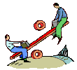
Balanced vs. unbalanced forces
Unbalanced: when the net force on an object is not zero. These produce a change in motion.
Balanced: when the net force on an object equals zero. These do NOT produce change in motion.

Slide 7
The Phenomenon
Watch this video – use your faster higher stronger paper in your journal
Now we will watch this video

Slide 8
What is this unbalanced force that acts on an object in motion?
Friction!
There are four main types of friction:
  Sliding friction: ex. ice skating
  Rolling friction: ex. bowling
  Fluid friction (air or liquid): ex. air or water resistance
  Static friction: ex. initial friction when moving an object

Slide 9
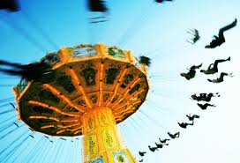
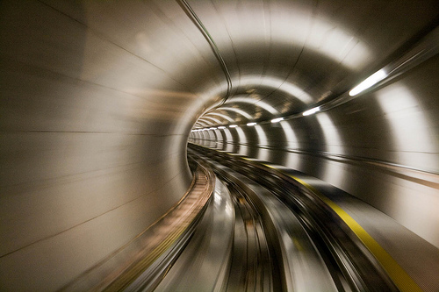
What is motion?
When an object changes position over time when compared with a reference point we say that the object is in motion.

Slide 10
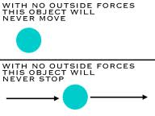
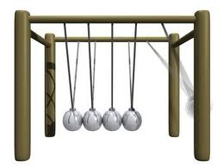
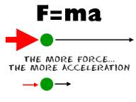
Newton’s Laws of Motion
1
3
2

Slide 11
Newton’s First Law
(law of inertia)
1
An object at rest tends to stay at rest and an object in motion tends to stay in motion unless acted upon by an unbalanced force.

Slide 12
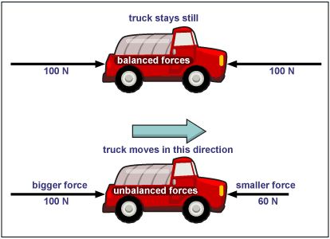
Balanced Force
Equal forces in opposite
directions produce no motion

Slide 13
Unbalanced Forces
Unequal opposing forces
produce an unbalanced force
causing motion

Slide 14
Newton’s First Law (law of inertia)
Mass (kg)is the measure of the amount of matter in an object.
INERTIA is a property of an object that describes how much it will resist change to the motion of the object
More mass an object has means more inertia the object will have.

Slide 15
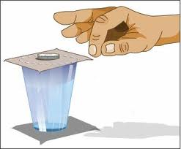
This will help up remember:
Newton’s First Law video clip

Slide 16
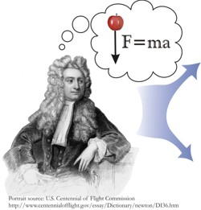
Newton’s Second Law
2
Force equals mass times acceleration.

Slide 17
Newton’s Second Law
Force = Mass x Acceleration
Force is measured in Newtons
ACCELERATION of GRAVITY Earth) = 9.8 m/s²
WEIGHT is a measure of the force of gravity on the mass of an object
Weight (force) = mass x gravity (Earth)

Slide 18
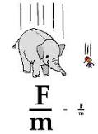
This will help up remember:
Newton’s Second Law video clip

Slide 19
Newton’s Third Law
3
For every action there is an equal and opposite reaction.

Slide 20
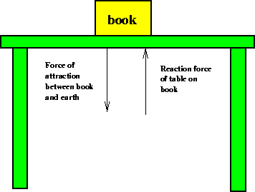
Newton’s 3rd Law
For every action there is an equal and opposite reaction.
Book to
earth
Table to
book

Slide 21
Think about it . . .
What happens if you are standing on a skateboard or a slippery floor and push against a wall? You slide in the opposite direction (away from the wall), because you pushed on the wall but the wall pushed back on you with equal and opposite force.
Why does it hurt so much when you stub your toe? When your toe exerts a force on a rock, the rock exerts an equal force back on your toe. The harder you hit your toe against it, the more force the rock exerts back on your toe (and the more your toe hurts).

Slide 22

Action and Reaction on Different Masses
Consider you and the earth
Action: earth pulls on you
Reaction: you pull on earth

Slide 23
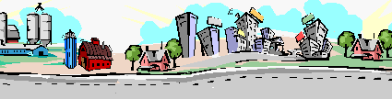

Action: tire pushes on road
Reaction: road pushes on tire

Slide 24


Reaction: gases push on rocket
Action: rocket pushes on gases

Slide 25
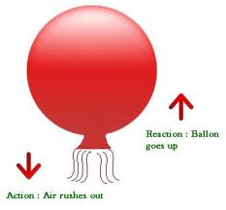
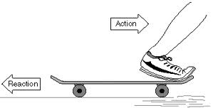
This will help up remember:
Newton’s Third Law video clip

Slide 26
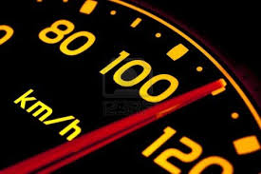
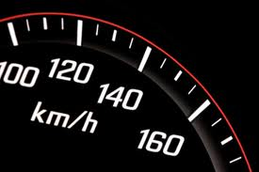
Speed
The rate at which an object moves.
Depends on distance traveled and the time it takes to travel that distance.

Slide 27

Speed Formula
Average speed = total distance
total time

Slide 28

Velocity
The speed of an object in a particular direction
***Don’t confuse this with speed…they don’t mean the same thing!!

Slide 29
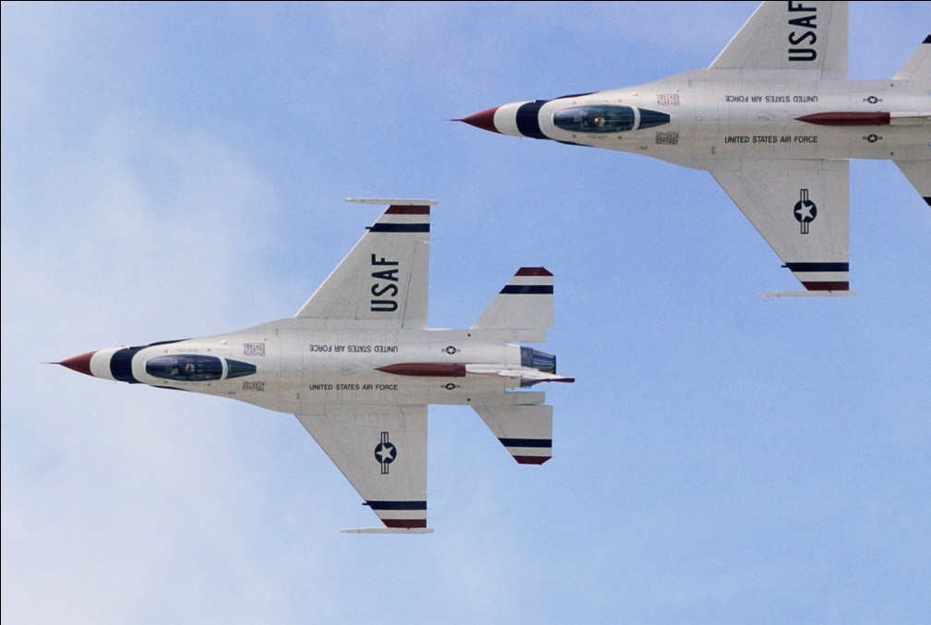
Velocity must ALWAYS include a direction
Ex: an airplane’s velocity might be 600 km/h south

Slide 30

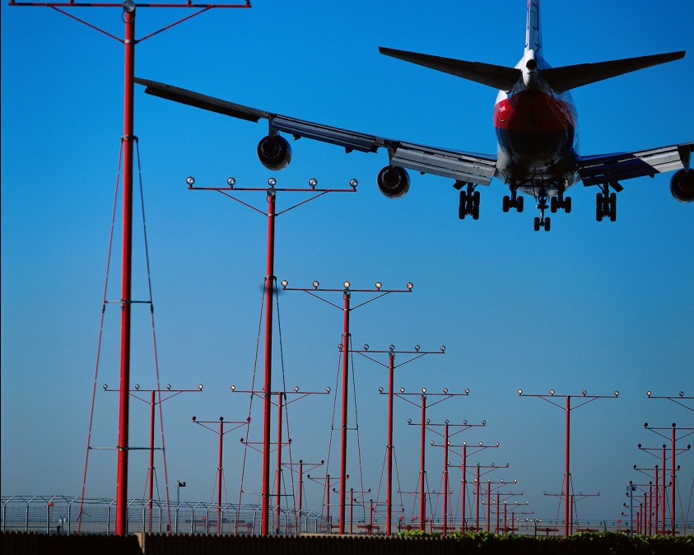
Velocity changes as speed OR direction changes

Slide 31
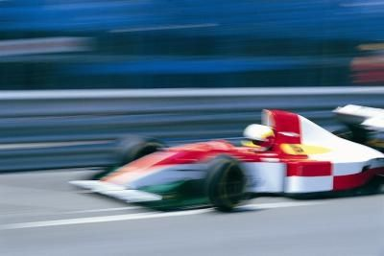
Acceleration
The rate at which velocity changes.
To change velocity (change speed or direction or BOTH)

Slide 32
It is not just HOW MUCH velocity changes, but it is also HOW FAST it changes.
The faster velocity changes, the greater the acceleration is.

Slide 33

Now its time to create your own…
You will each be assigned a specific topic within Force and Motion.
You with be responsible for creating a 2-3 minute review video for your topic. Each of you are about to receive the rubric for how your video will be graded.
Using the information you have just reviewed, develop a plan for how you want to present your material.
You will have the rest of the class period to work on this project.

