Slide 1
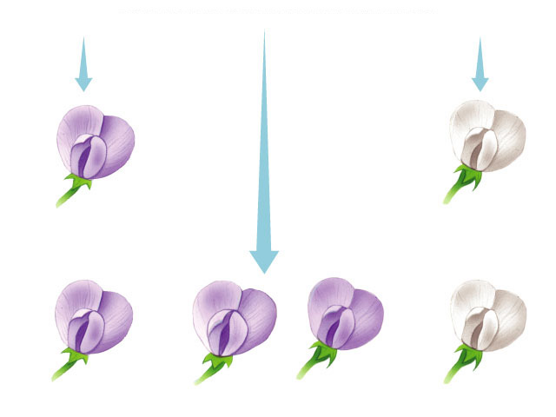
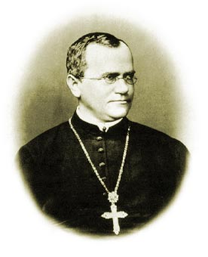
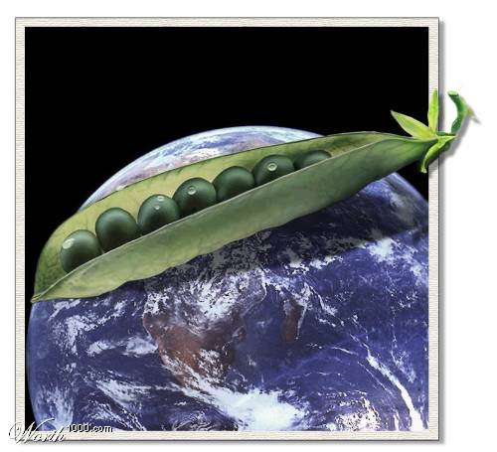
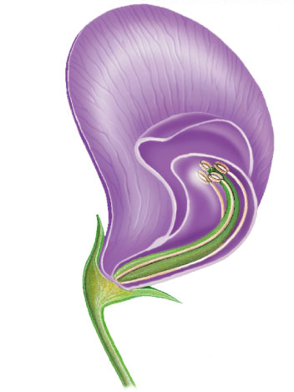
Mendellian Genetics

Slide 2
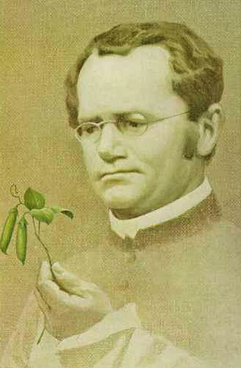
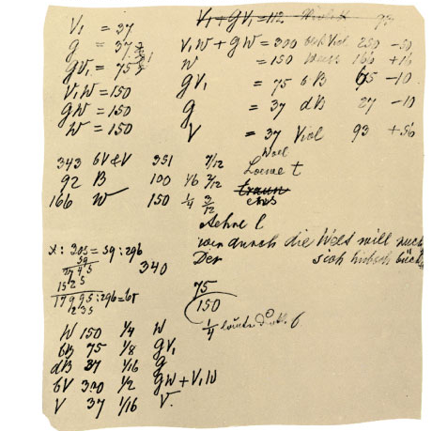
Gregor Mendel
Modern genetics began with Gregor Mendel and his peas
  Monk in the 1800s
  used quantitative analysis
    collected data & counted them
  excellent example of the scientific method
Notes:
He studied at the University of Vienna from 1851 to 1853 where he was influenced by a physicist who encouraged experimentation and the application of mathematics to science and a botanist who aroused Mendel’s interest in the causes of variation in plants. After the university, Mendel taught at the Brunn Modern School and lived in the local monastery.
The monks at this monastery had a long tradition of interest in the breeding of plants, including peas. Around 1857, Mendel began breeding garden peas to study inheritance.

Slide 3
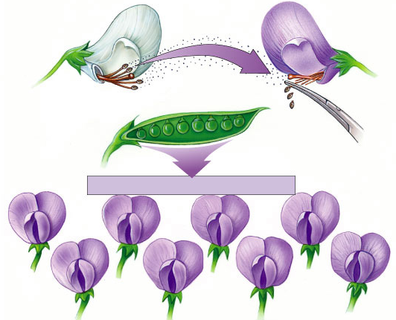
Mendel’s work
Pollen transferred from white flower to stigma of purple flower
Bred pea plants
  cross-pollinate
  true breeding parents (P)
    P = parental
  raised seed & then
  observed traits (F₁)
    F = filial
  allowed offspring
  to self-pollinate
  & observed next
  generation (F₂)
P
all purple flowers result
F₁
self-pollinate
F₂
Notes:
P = parents
F = filial generation

Slide 4
Looking closer at Mendel’s work
true-breeding
purple-flower peas
true-breeding
white-flower peas
P
X
Where did
the white
flowers go?
F₁
generation
(hybrids)
100%
purple-flower peas
100%
White
flowers came
back!
self-pollinate
75%
purple-flower peas
25%
white-flower peas
3:1
F₂
generation
Notes:
In a typical breeding experiment, Mendel would cross-pollinate (hybridize) two contrasting, true-breeding pea varieties.
The true-breeding parents are the P generation and their hybrid offspring are the F₁ generation.
Mendel would then allow the F₁ hybrids to self-pollinate to produce an F₂ generation.

Slide 5
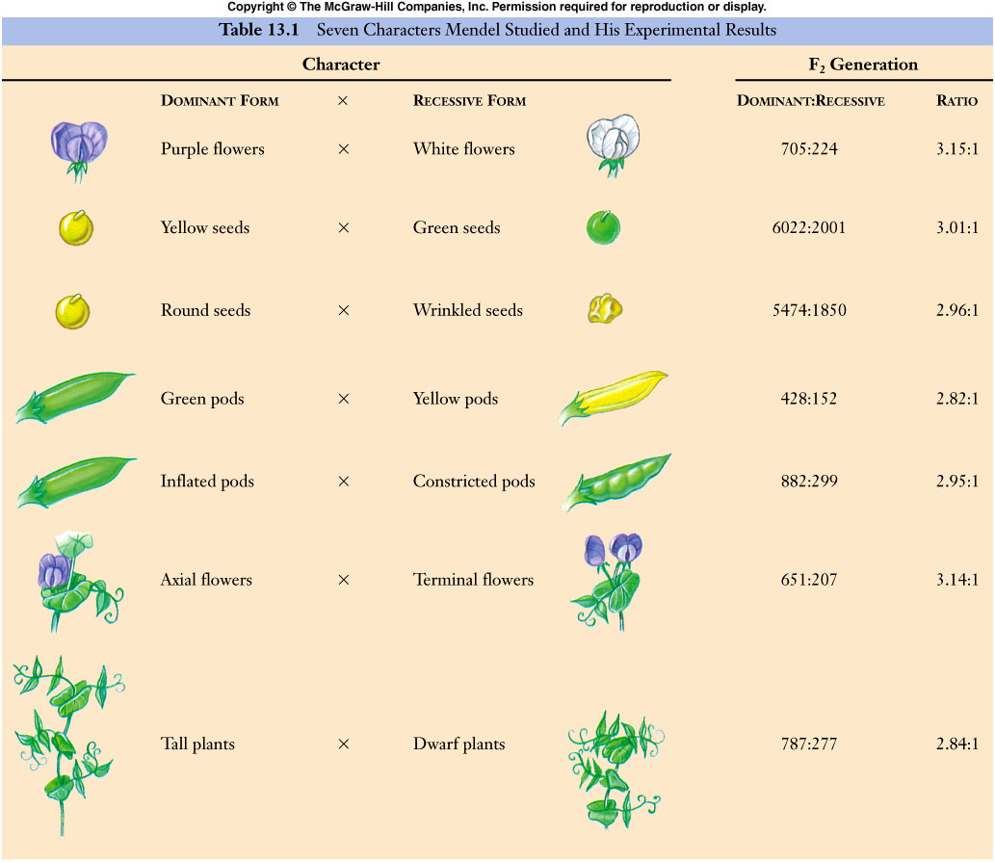
Mendel collected data for 7 pea traits

Slide 6
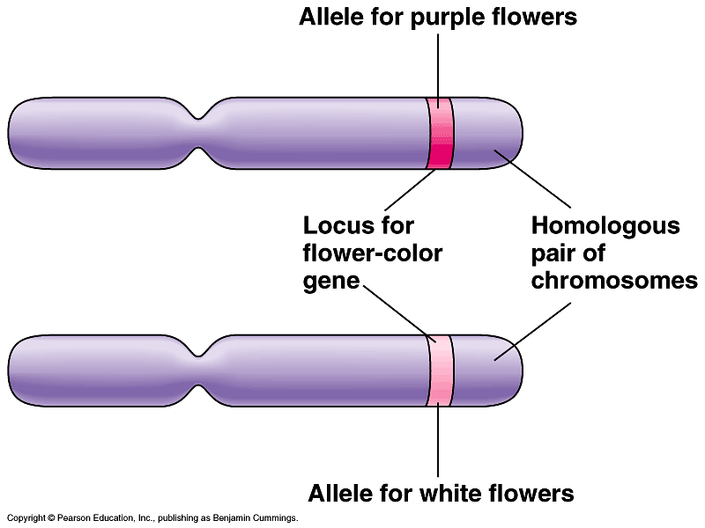
What did Mendel’s findings mean?
Traits come in alternative versions
  purple vs. white flower color
  Alleles
  For each characteristic, an organism inherits 2 alleles, 1 from each parent
different versions of gene at same location on homologous chromosomes

Slide 7
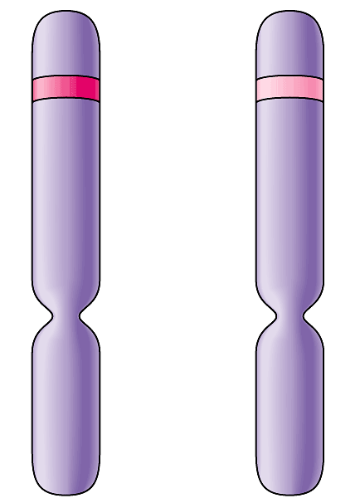
What did Mendel’s findings mean?
Some traits mask others
  purple & white flower colors are separate traits that do not blend
    purple x white ≠ light purple
    purple masked white
  dominant allele (P)
    masks other alleles
  recessive allele (p)
    Hidden when dominant is present
I’ll speak for
both of us!
Dominant
Purple
Recessive
White
homologous
chromosomes

Slide 8
Genotype
Can represent alleles as letters
  flower color alleles → P or p
  true-breeding purple-flower peas → PP
  true-breeding white-flower peas → pp
Homozygous = same alleles = PP, pp
Heterozygous = different alleles = Pp
PP
x
pp
P
X
purple
white
Pp
F₁
all purple

Slide 9
Genotype vs. phenotype
Difference between how an organism “looks” & its genetics
  phenotype
    description of an organism’s trait
    the “physical”
  genotype
    description of an organism’s genetic makeup
P
X
Explain Mendel’s results using
…dominant & recessive
…phenotype & genotype
purple
white
F₁
all purple

Slide 10
Looking closer at Mendel’s work
true-breeding
purple-flower peas
true-breeding
white-flower peas
phenotype
P
X
PP
pp
genotype
F₁
generation
(hybrids)
100%
purple-flower peas
100%
Pp
Pp
Pp
Pp
self-pollinate
75%
purple-flower peas
25%
white-flower peas
3:1
F₂
generation
?
?
?
?
Notes:
In a typical breeding experiment, Mendel would cross-pollinate (hybridize) two contrasting, true-breeding pea varieties.
The true-breeding parents are the P generation and their hybrid offspring are the F₁ generation.
Mendel would then allow the F₁ hybrids to self-pollinate to produce an F₂ generation.

Slide 11
Punnett squares
Aaaaah,
phenotype & genotype
can have different
ratios
Pp x Pp
F₁
generation
(hybrids)
%
genotype
%
phenotype
male / sperm
PP
P
p
25%
Pp
75%
P
PP
Pp
50%
Pp
female / eggs
p
Pp
pp
25%
25%
pp
1:2:1
3:1

Slide 12
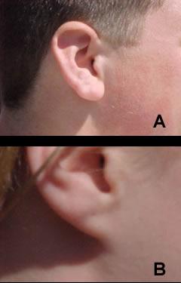
Practice
In humans, free earlobes (E) are dominant to attached earlobes (e)
What will the offspring of a man with free earlobes and a woman with attached earlobes look like?
X
=
???
Free (E)
Attached (e)

Slide 13
X
=
???
Free (E)
Attached (e)

Slide 14
Probability
Probability = the chance something will occur
  Probability of purple flowers?
    75%, ¾, 3:1
  Probability of being heterozygous?
    50%, ½, 1:1
Pp x Pp
male / sperm
P
p
P
PP
Pp
female / eggs
p
Pp
pp

Slide 15
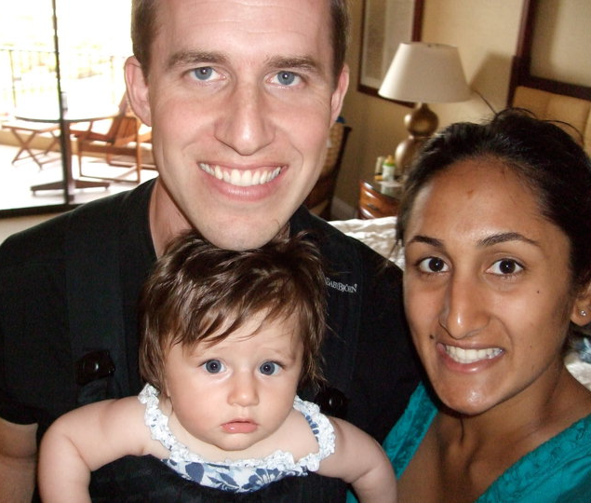
Remember my brother’s family?
What are their phenotypes?
  Bret = blue eyes
  Karen = brown eyes
  Jazzy = blue eyes
What are their genotypes?
  Bret = bb
  Karen = Bb
  Jazzy = bb
What is the probability that their next child will have blue eyes?

Slide 17
