Slide 1
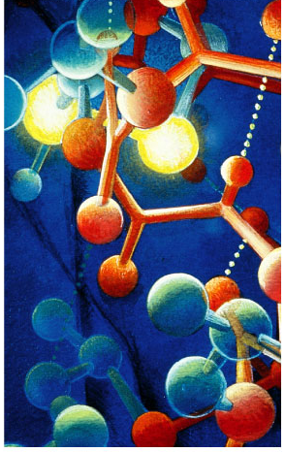
The Chemistry of Life
What are living
creatures made of?

Slide 2
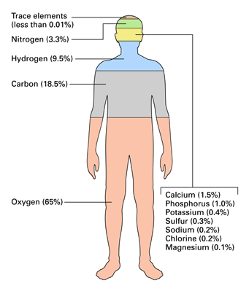
Elements of Life
96% of living organisms are made of:
  hydrogen (H)
  oxygen (O)
  nitrogen (N)
  carbon (C)

Slide 3
Molecules of Life
Put H, O, N, C together in different
ways to build living organisms
What are bodies made of?
  Carbohydrates
    sugars & starches
  Lipids
    fats & oils
  Proteins
  Nucleic acids
    DNA & RNA

Slide 4
Building large molecules of life
How do we get these molecules?
  We build them!
Building block molecules = monomers
Chains of monomers = polymers

Slide 5
Carbohydrates

Slide 6


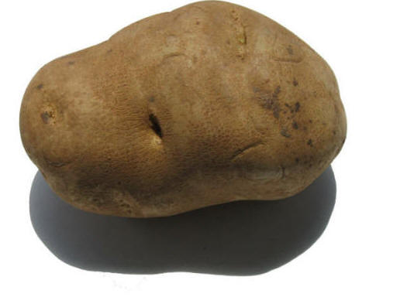
Carbohydrate functions
quick energy
energy storage
structure

Slide 7
Making a carbohydrate
Monomer = monosaccharide (one sugar)
Polymer = disaccharide (two sugars) or polysaccharide (many sugars)
sugar
monosaccharide
sugar
sugar
disaccharide
sugar
sugar
sugar
sugar
sugar
sugar
sugar
sugar
polysaccharide

Slide 8
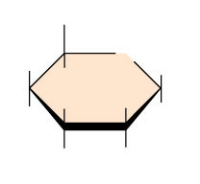

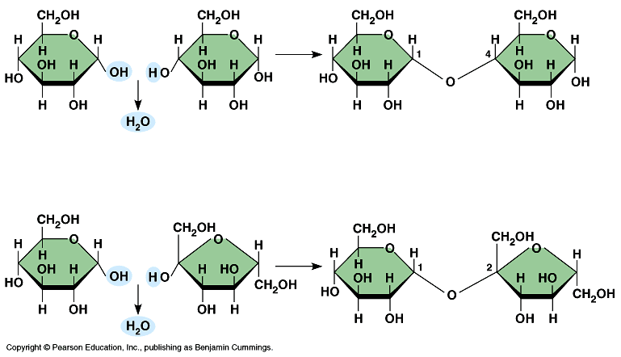
Sugar examples
Names for sugars usually end in -ose
  glucose
  fructose
  sucrose
  maltose
CH₂OH
H
O
H
H
OH
H
HO
OH
H
OH
glucose
C₆H₁₂O₆
fructose
maltose
sucrose

Slide 9
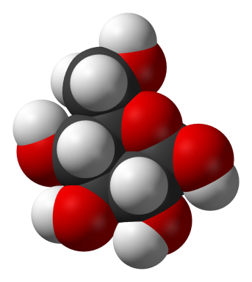
Building carbohydrates
Form bonds with dehydration synthesis (remove water)
Break bonds = hydrolysis (water separation)
Adios water!
|
glucose
|
fructose
|
sucrose
(table sugar)

Slide 10
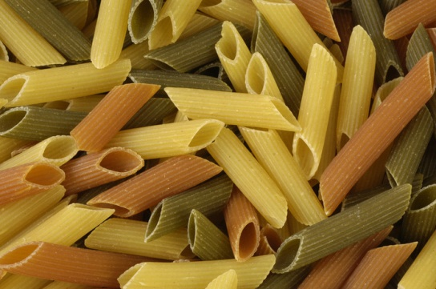

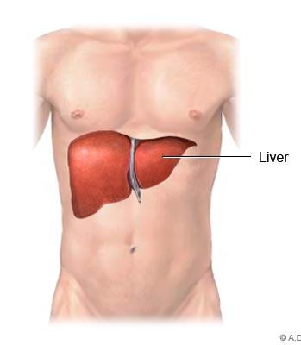
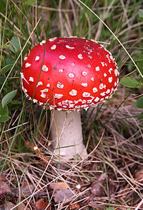
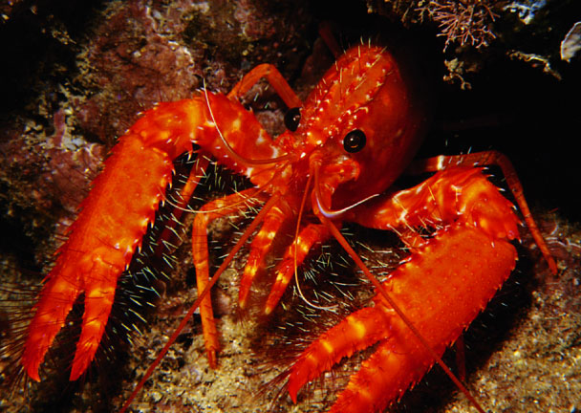
BIG carbohydrates
Polysaccharides
  starch
    energy storage in plants
      potatoes, pasta
  glycogen
    energy storage in animals
      in liver & muscles
  cellulose
    structure in plants
      cell walls
  chitin
    Cell wall in fungi and exoskeleton in arthropods (bugs, lobsters, etc.)

Slide 11
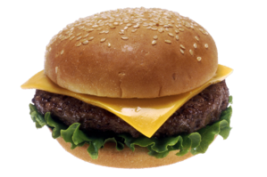
Lipids

Slide 12
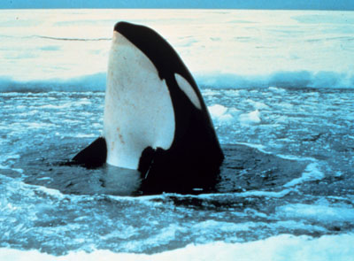
Lipid function
Long-term energy storage
  very concentrated
  twice the energy of carbohydrates!
Cell membrane
  phospholipids
Cushion organs
Insulate body
  think whale blubber!

Slide 13
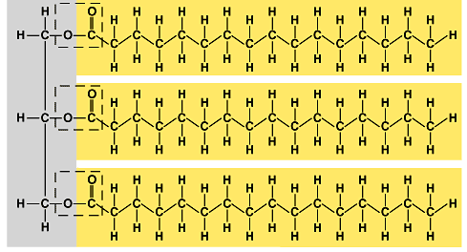
Structure of fat
Monomers = glycerol and fatty acids
Polymer = triglyceride (three fatty acids)
fatty acids
glycerol

Slide 14

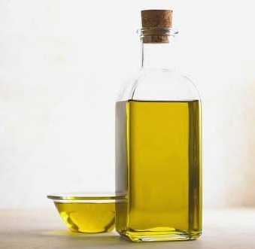
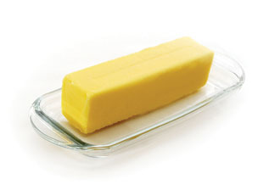
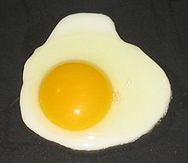

Lipid examples
fats
oils
waxes
steroids
  sex hormones
  cholesterol
  anabolic steroids
  (the bad ones!)

Slide 15
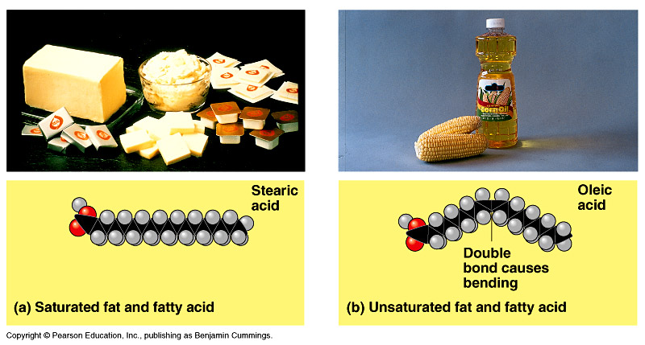
Saturated fats
Saturated with hydrogen
Most animal fats
  solid at room
  temperature
Limit the amount in your diet
  contributes to heart disease

Slide 16
Unsaturated fats
Missing some hydrogen
  Causes bending
Plant, vegetable &
fish fats
  liquid at room
  temperature
  the fat molecules
  don’t stack tightly
  together
Better choice in your
diet

Slide 17
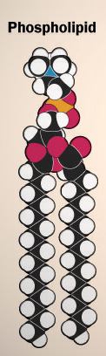
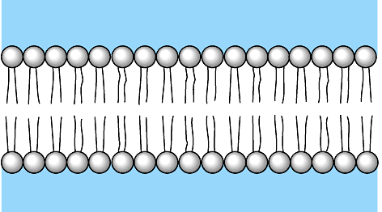
Other lipids in biology
Cell membranes are made out of phospholipids
  Phosphate heads are on the outside touching water
    “like” water
  Fatty acid tails are on inside away from water
    “scared” of water
  forms a bi-layer
  between the cell
  & the outside

Slide 18
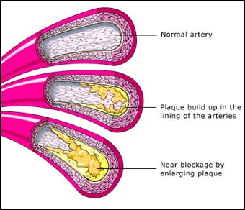
Other lipids in biology
Cholesterol
  Makes cell membranes more rigid
  make hormones
  from it
    including sex
    hormones
  too much may lead
  to heart disease

Slide 19
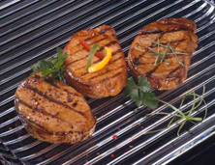
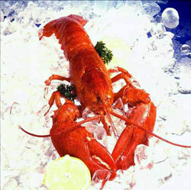
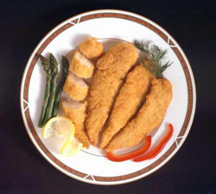
Proteins

Slide 20
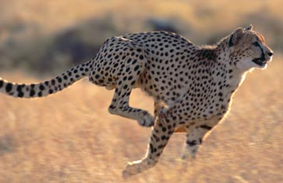
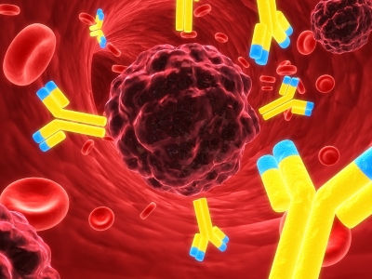
Protein function
Many, many functions!
  hormones
    signals from one body system to another
  movement
  immune system
    antibodies
  enzymes
    make chemical
    reactions faster

Slide 21
Proteins
Monomer = amino acids
amino
acid
–
amino
acid
–
amino
acid
–
amino
acid
–
amino
acid
20 different amino acids
There’s
20 of us…
like 20 different
letters in an
alphabet!
Can make lots of
different
words
O
H
H
|
—C—
|
||
C—OH
—N—
H
Variable “R”
group

Slide 22
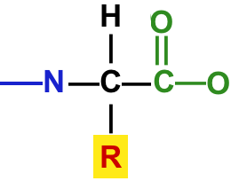
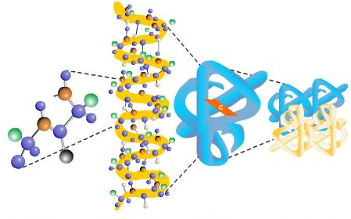
Amino acid chains
Polymer = polypeptide
  amino acids chain with peptide bonds
Polypeptides fold
into proteins
amino acid
amino acid
amino acid
amino acid
amino acid

Slide 23
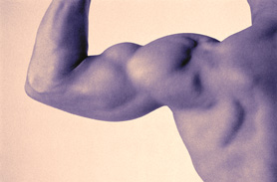
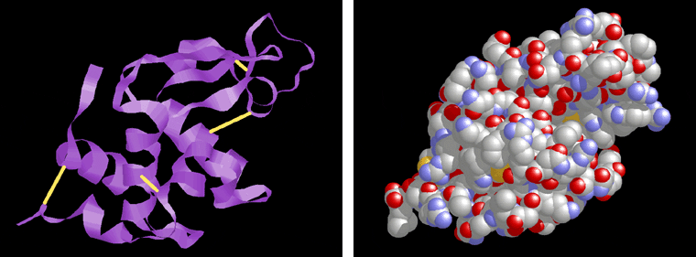
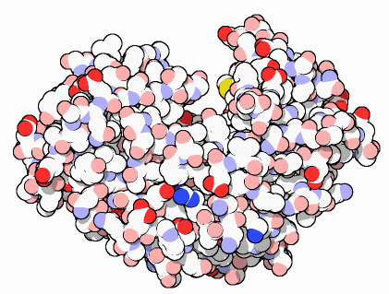
Protein examples
muscle
skin, hair, fingernails, claws
  collagen, keratin
pepsin
  digestive enzyme
  in stomach
insulin
  hormone that controls blood sugar levels
insulin
pepsin
collagen (skin)

Slide 24
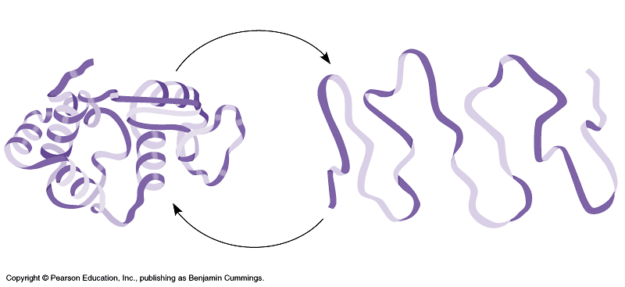
It’s SHAPE that matters!
Proteins can do their jobs because
of their shape
Unfolding a protein destroys its shape
  wrong shape = can’t do its job
  unfolding proteins = “denature”
    temperature
    pH (acidity)
unfolded
“denatured”
folded

Slide 25
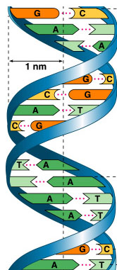
Nucleic Acids
Information molecules
Examples
  DNA
    DeoxyriboNucleic Acid
  RNA
    RiboNucleic Acid
RNA
DNA

Slide 26
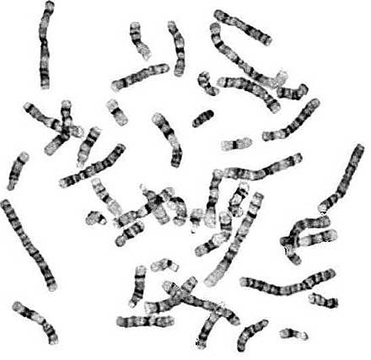
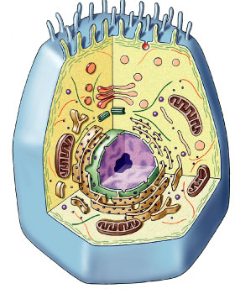
Nucleic acid function
genetic material
  stores information
    genes
  transfers information
    blueprint for building proteins
      DNA → RNA → proteins
DNA
proteins

Slide 27
Nucleic acids
Monomer = nucleotides
nucleotide – nucleotide – nucleotide – nucleotide
Sugar, phosphate, base
  different nitrogen bases
  A, T, C, G, U
Nitrogen bases
I’m the
A,T,C,G or U
part!
sugar
N base
phosphate

Slide 28
Nucleotide chains
sugar
N base
Nucleic acid polymers = DNA & RNA
  DNA
    double helix
    A, C, G, T
  RNA
    single stranded
    A, C, G, U
phosphate
sugar
N base
phosphate
sugar
N base
phosphate
sugar
N base
phosphate
RNA

