Slide 1
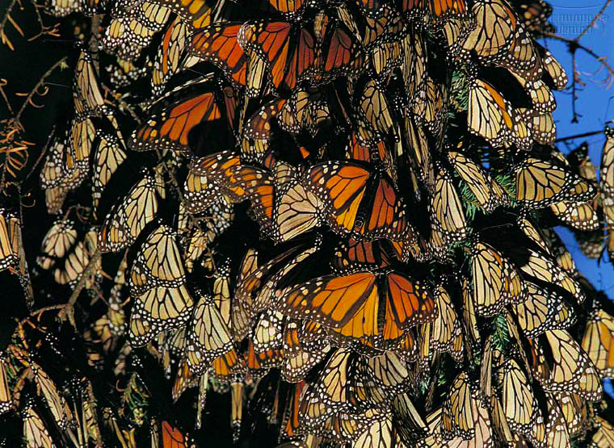
Population Ecology

Slide 2
Studying organisms in their environment
biosphere
ecosystem
community
population
organism
biosphere

Slide 3
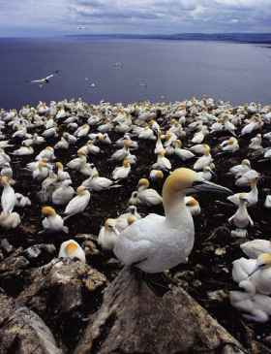
Life takes place in populations
Population
  group of individuals of same species in same area at same time
rely on same resources
interact
interbreed
Population Ecology: What factors affect a population?

Slide 4
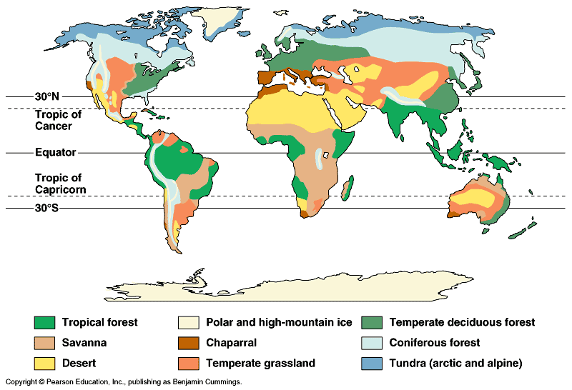
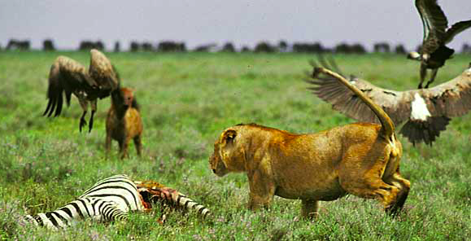
Factors that affect Population Size
Abiotic (non-living) factors
  sunlight / temperature
  precipitation / water
  nutrients
Biotic (living) factors
  food
  competitors
  predators
  disease
Intrinsic factors
  adaptations

Slide 5
Population Size
Changes to population size
  Add individuals
    Birth
    Immigration
      New organisms arrive from somewhere else
  Remove individuals
    Death
    Emigration
      Organisms leave for somewhere else

Slide 6
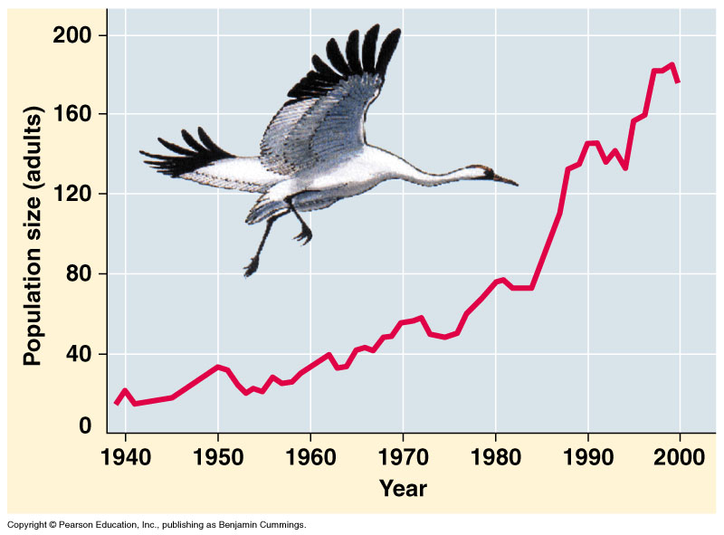
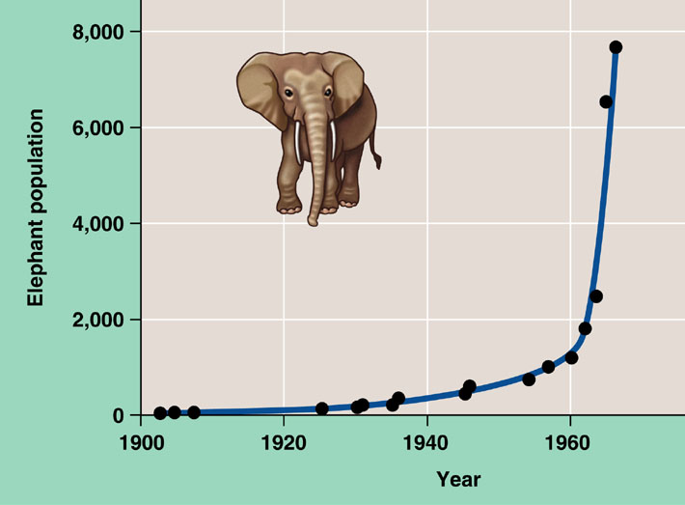
Exponential growth rate
Characteristic of populations WITHOUT
limiting factors
  introduced to a new environment or rebounding from a catastrophe
Whooping crane
coming back from near extinction
African elephant
protected from hunting
Notes:
The J–shaped curve of exponential growth is characteristic of some populations that are introduced into a new or unfilled environment or whose numbers have been drastically reduced by a catastrophic event and are rebounding. The graph illustrates the exponential population growth that occurred in the population of elephants in Kruger National Park, South Africa, after they were protected from hunting. After approximately 60 years of exponential growth, the large number of elephants had caused enough damage to the park vegetation that a collapse in the elephant food supply was likely, leading to an end to population growth through starvation. To protect other species and the park ecosystem before that happened, park managers began limiting the elephant population by using birth control and exporting elephants to other countries.

Slide 7
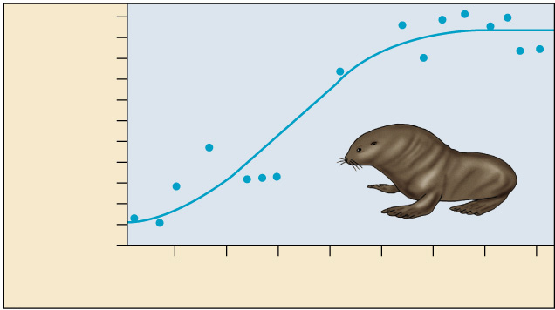
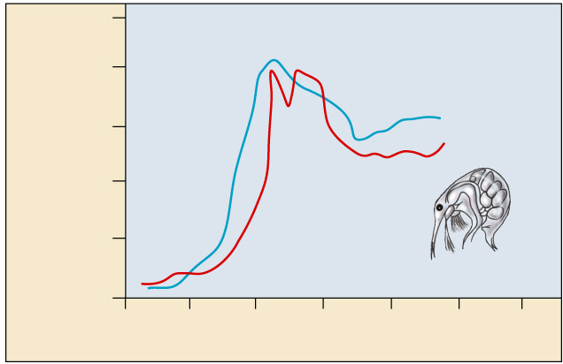
Carrying capacity
Exponential growth NOT sustainable
Carrying capacity = Maximum population size that environment can support
10
8
Number of breeding male
fur seals (thousands)
6
4
2
0
1915
1925
1935
1945
Time (years)
500
400
Number of cladocerans
(per 200 ml)
300
200
100
0
0
10
20
30
40
50
60
Time (days)

Slide 8
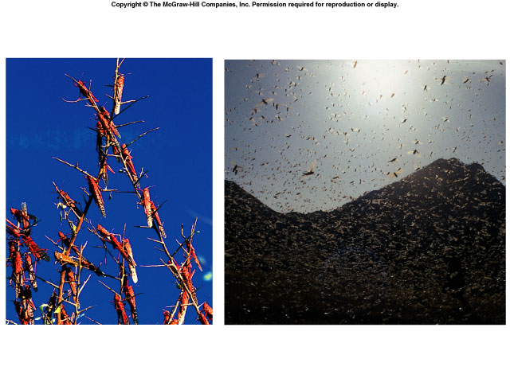
Regulation of population size
marking territory
= competition
What keeps populations in check?
  competition: food, mates, nesting sites
  predators, parasites, pathogens
  abiotic factors
    sunlight (energy)
    temperature
    rainfall
swarming locusts
competition for nesting sites

Slide 9
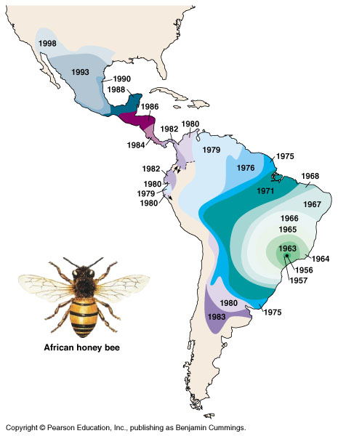
Introduced species
Non-native species
  transplanted populations grow exponentially in new area
  out-compete native species
    loss of natural controls
    Don’t have predators, parasites, or competitors
  reduce diversity
  examples
    African honeybee in the
    Americas
    Kudzu in Southern US
    Rabbits in Australia
kudzu

Slide 10
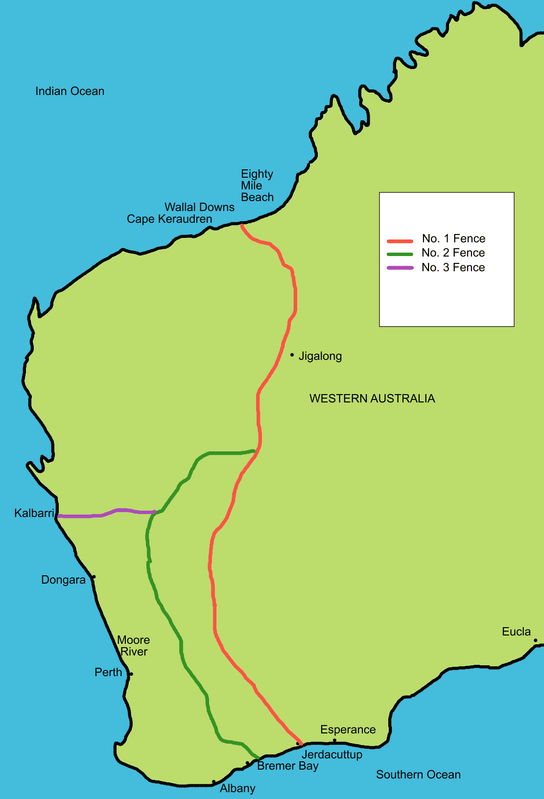
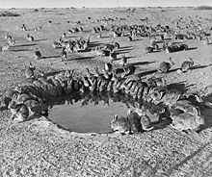
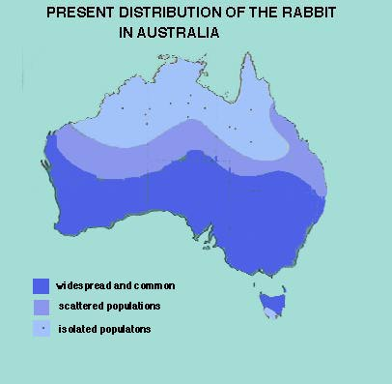
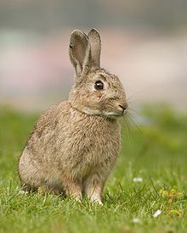
Rabbits in Australia
Introduced in 1859 by Thomas Austin (he wanted to hunt them)
  No natural predators
  Mild temperature meant they could breed year-round
Population grew exponentially
  Erosion because rabbits ate vegetation
  Mass extinction of native species
Tried to stop the spread with “rabbit-proof” fence
  Unsuccessful (why?)

Slide 11
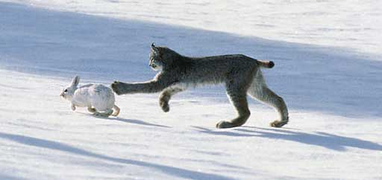
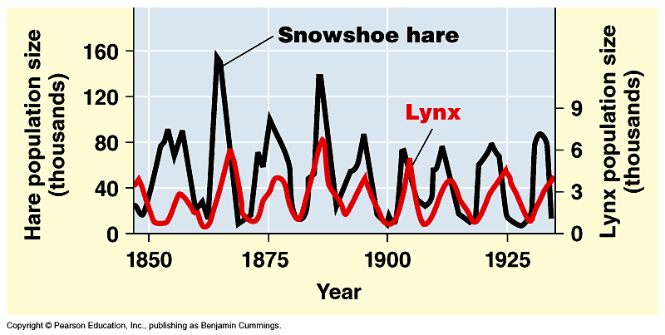
Changes in Carrying Capacity
Population cycles
  predator – prey interactions
At what
population level is the
carrying capacity?

Slide 12
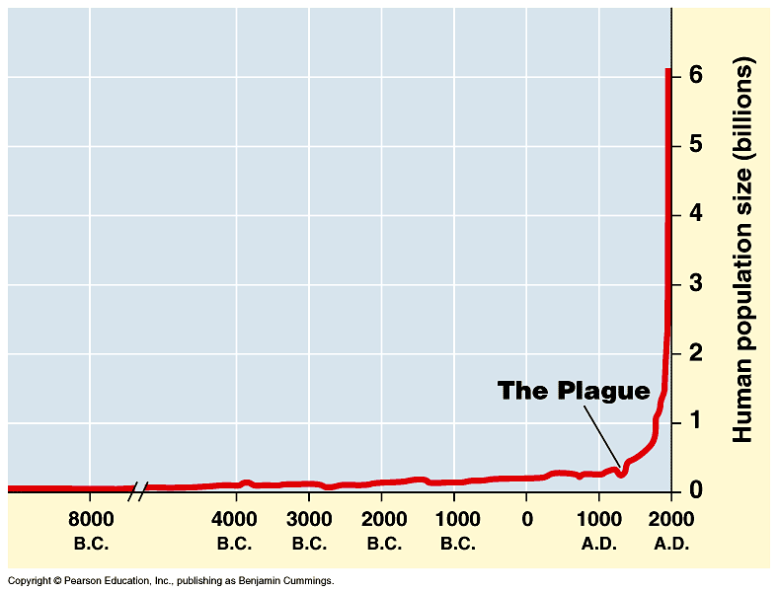
Human population growth
What factors have contributed to this exponential growth pattern?
2005→6 billion
2011 = 7 billion people!
adding 82 million/year
~ 200,000 per day!
Significant advances
in medicine through
science and technology
Industrial Revolution
Is the human
population reaching
carrying capacity?
Bubonic plague "Black Death"
1650→500 million
Notes:
The population doubled to 1 billion within the next two centuries, doubled again to 2 billion between 1850 and 1930, and doubled still again by 1975 to more than 4 billion. The global population now numbers over 6 billion people and is increasing by about 73 million each year. The population grows by approximately 201,000 people each day, the equivalent of adding a city the size of Amarillo, Texas, or Madison, Wisconsin. Every week the population increases by the size of San Antonio, Milwaukee, or Indianapolis. It takes only four years for world population growth to add the equivalent of another United States. Population ecologists predict a population of 7.3–8.4 billion people on Earth by the year 2025.

