Slide 1
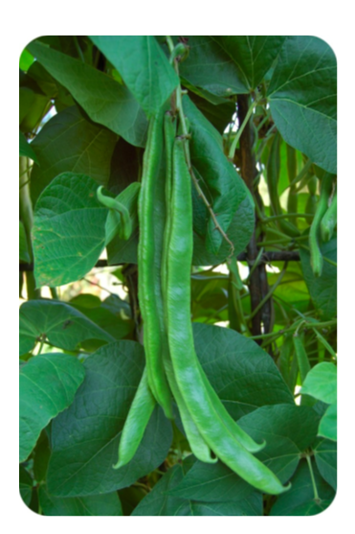
The Nitrogen Cycle

Slide 2
Why Beans?
What can bean plants do that most other plants can't?
No, they don't grow giant stalks to the clouds. Bean plants and other legumes (plants that have their seeds in pods) can use the nitrogen in the air to grow. It takes the help of special bacteria friends in the soil, and this relationship is unique to the legumes.

Slide 3
The Basic Cycle
Nitrogen is unusable in its gaseous form to most organisms. Nitrogen gas (N2) has two nitrogen atoms connected by a very strong triple bond. Most plants and animals cannot use the nitrogen in nitrogen gas because they cannot break that triple bond.
Legume plants have special nitrogen fixating bacteria which allow them to use nitrogen straight from the atmosphere.
Otherwise nitrogen must be converted in order for organisms to get it in an useable form. Like water and carbon, nitrogen is also repeatedly recycled through the biosphere. This process is called the nitrogen cycle. Nitrogen is one of the most common elements in living organisms.
It is important for creating both proteins and nucleic acids, like DNA. The air that we breathe is mostly nitrogen gas (N2), but, unfortunately, animals and plants cannot use the nitrogen when it is a gas.

Slide 5
How Does Nitrogen Become Useable
In order for plants to make use of nitrogen, it must be transformed into molecules they can use. This can be accomplished several different ways of making nitrogen available:
1. Lightning: Nitrogen gas can be transformed into
nitrate (NO3-) that plants can use when lightning strikes.
2. Nitrogen fixation: Special nitrogen-fixing bacteria can also transform nitrogen gas into useful forms. These bacteria live in the roots of plants in the pea (legume) family. They turn the nitrogen gas into ammonium (NH4+). In water environments, bacteria in the water can also fix nitrogen gas into ammonium. Ammonium can be used by aquatic plants as a source of nitrogen.
3. Nitrogen also is released to the environment by decaying organisms or decaying wastes.
These wastes release nitrogen in the form of ammonium.

Slide 6
How is Nitrogen Returned to the Atmosphere
Turning nitrate back into nitrogen gas, the process of denitrification, happens through the work of denitrifying bacteria. These bacteria often live in swamps and lakes. They take in the nitrate and release it back to the atmosphere as nitrogen gas.

Slide 7
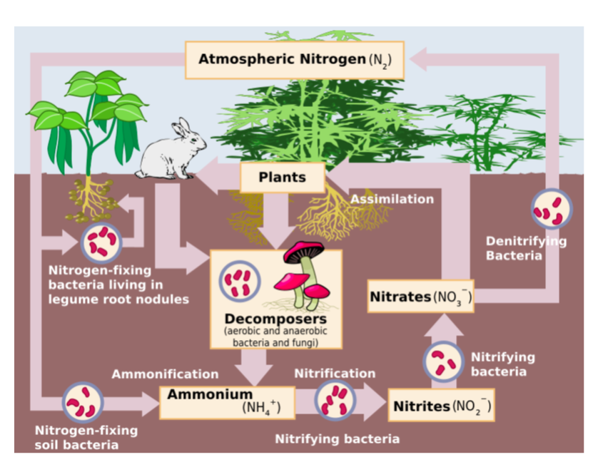

Slide 8
The Three Sisters
The Three Sisters are the three main agricultural crops of various Native American groups in North America: squash, maize (corn), and climbing beans.
In one technique known as companion planting, the three crops are planted close together. The three crops benefit from each other. The maize provides a structure for the beans to climb, eliminating the need for poles. The beans provide the nitrogen to the soil that the other plants utilize, and the squash spreads along the ground, blocking the sunlight, helping prevent establishment of weeds.
Native Americans throughout North America are known for growing variations of Three Sisters gardens.

Slide 9
Think Pair Share
How do we currently add Nitrogen to soil to help plants grow?
Is there a better way to add Nitrogen to soil?

Slide 10
Human Effects
Just like the carbon cycle, human activities impact the nitrogen cycle. These human activities include the burning of fossil fuels, which release nitrogen oxide gasses into the atmosphere. Releasing nitrogen oxide back into the atmosphere leads to problems like acid rain.

