Slide 1
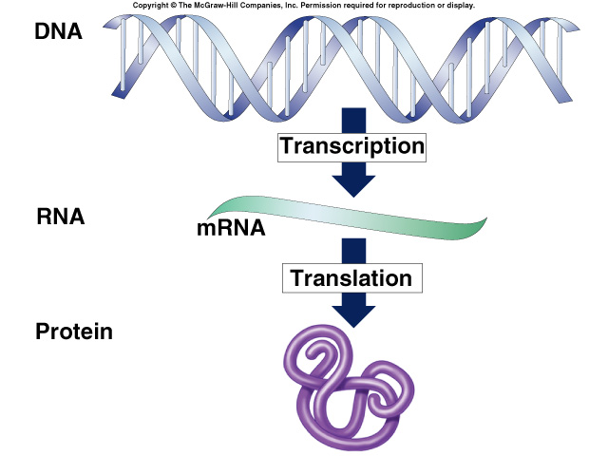
Part 3: Translation
from nucleotide language to amino acid language

Slide 2
How does mRNA code for proteins?
DNA
TACGCACATTTACGTACG
4
ATCG
mRNA
AUGCGUGUAAAUGCAUGC
4
AUCG
?
protein
MetArgValAsnAlaCys
20
How can you code for 20 amino acids with only 4 nucleotide bases (A,U,G,C)?

Slide 3
mRNA codes for proteins in triplets
DNA
TACGCACATTTACGTACG
codon
AUGCGUGUAAAUGCAUGC
mRNA
AUGCGUGUAAAUGCAUGC
mRNA
?
protein
MetArgValAsnAlaCys

Slide 4
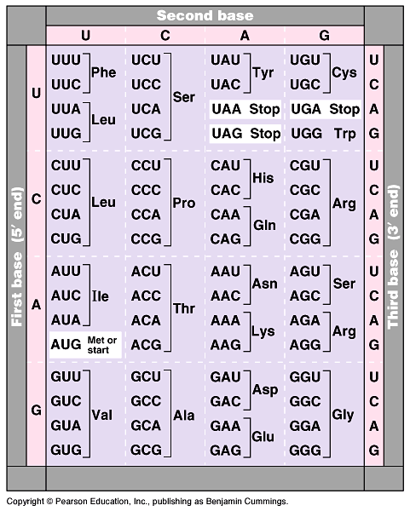
The code
Code for ALL life!
strongest support for a common origin for all life
Code is redundant
several codons for each amino acid
Start codon
AUG
methionine
Stop codons
UGA, UAA, UAG
Notes:
Strong evidence for a single origin in evolutionary theory.

Slide 5
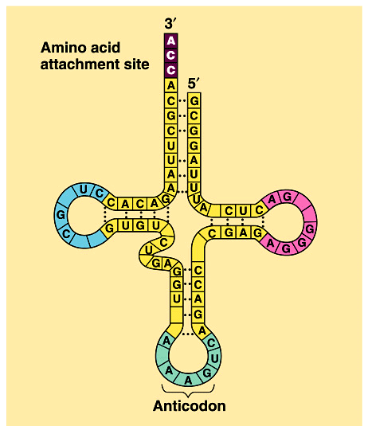
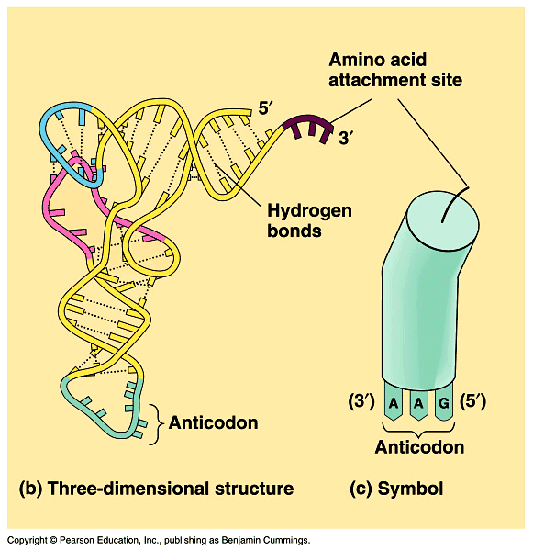
Transfer RNA structure
“Clover leaf” structure
anticodon on “clover leaf” end
amino acid attached on 3′ end

Slide 6
How are the codons matched to amino acids?
DNA
3′
TACGCACATTTACGTACG
5′
mRNA
5′
AUGCGUGUAAAUGCAUGC
3′
3′
5′
codon
UAC
GCA
tRNA
CAU
Met
anti-codon
amino acid
Arg
Val

Slide 7
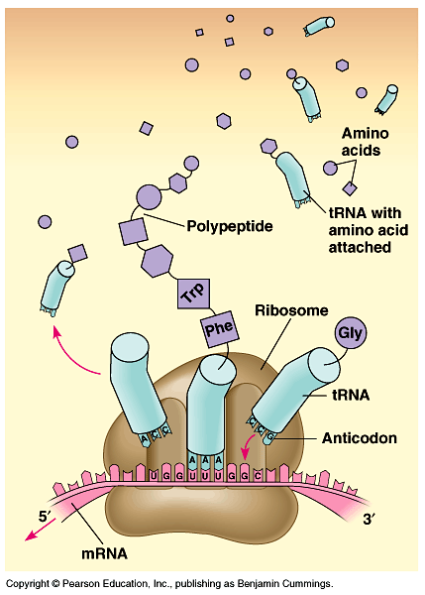
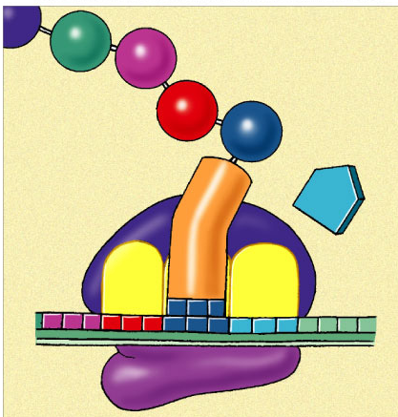
Building a polypeptide
Initiation
Start codon on mRNA, tRNA (Met)
Elongation
adding amino acids based on codon sequence
Termination
end codon
3
2
1
Leu
Val
Ser
release
factor
Met
Met
Ala
Met
Met
Leu
Leu
Leu
Trp
tRNA
A
C
G
U
A
C
U
A
C
G
A
C
U
A
C
G
A
C
A
U
A
C
G
A
C
U
5'
A
U
G
C
U
G
A
A
U
5'
A
U
G
C
U
G
A
A
U
5'
A
U
G
C
U
G
A
U
5'
A
U
G
C
U
G
A
A
3'
A
C
C
mRNA
3'
3'
3'
U
G
G
U
A
A
3'
E
P
A

Slide 8
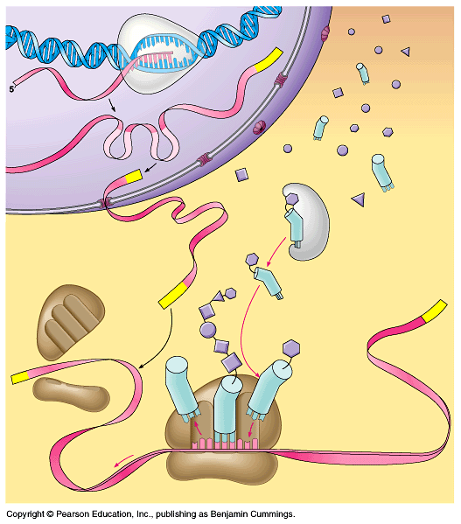
DNA
RNA polymerase
Can you tell the story?
Transcription
mRNA
polypeptide
3'
amino acid
5'
tRNA
Translation
ribosome

